Slide 1
Federal Policies and Programs: REO, WIOA, & “Community Repair”
Clarence Okoh, Senior Policy Counsel
Center for Law & Social Policy (CLASP)

Slide 2
About Today’s Presentation
In this session we will explore:
CLASP’s Community Repair Paradigm for Reentry
The U.S. Department of Labor’s Reentry Employment Opportunities Program
Recommendations that can better align REO with principles of community repair that can create conditions for systems transformation in local communities

Slide 3
About CLASP
The Center for Law and Social Policy (CLASP) is a national, nonpartisan, antipoverty organization advancing policy solutions for people with low-incomes and communities of color.
We work at the federal, state, and local levels to build power with low-income communities of color across multiple issue areas including: youth justice, mental health, child care & early education, worker justice, income and work supports & immigrant families.
Beginning in 2015, CLASP has pursued a cross-disciplinary body of work that explores the relationship between mass criminalization, poverty, and state violence. CLASP remains committed to co-creating anti-carceral public policies that build holistic models of public safety and upward economic mobility.

Slide 4
About Clarence
Clarence Okoh is a civil rights attorney and racial justice advocate whose work addresses the impact of mass criminalization and systemic divestment in Black communities, with a particular focus on Black youth and young adults. Clarence is currently Senior Policy Counsel for Justice at the Center for Law and Social Policy. He is also a Just Tech Fellow for the Social Science Research Council.

Slide 5
Who’s In the Room?

Slide 6
Today’s Roadmap

Slide 7
Roadmap
Introductions
CLASP’s Community Repair Framework for Reentry
Q & A
Reentry Employment Opportunities Program (REO): An Overview
Q & A
Aligning REO with Community Repair: A Workshop on the Future of REO
Closing
Resources

Slide 8
What is Community Repair?

Slide 9
From Community Supervision to Community Repair: A New Paradigm for Reentry
Recent Publication Outlining Anti-Carceral Policy Vision for Reentry & Community Supervision
Informed by a Series of Interviews and Focus Groups with Key Stakeholders Around the Country with a Particular Focus on Three States: Arizona, Oklahoma & Wisconsin
Identify Promising Policy Developments & Identify Paths to Systems Transformation

Slide 10
Community Repair
Community Repair is an anti-carceral policy framework informed by insights from the Black freedom struggle, transitional justice, and human rights principles.
The framework calls for the use of non-carceral, publicly funded, community-led services to meet the economic, wellness, and social needs of systems-impacted families and communities at scale.
Community repair seeks structural redress for structural harms. A community repair paradigm calls for systems transformation that addresses both acute harms to individuals in conjunction with longstanding practices of systemic divestment and mass criminalization in Black and brown communities.

Slide 11
Community Repair Strategies
Relocate Reentry Systems
Subsidized Employment Strategies & Postsecondary Educational Investments At-Scale
Carceral Debt Jubilee
Direct Cash Transfer Pilots & Access to Benefits
Protected Class Status for People with Criminal Records

Slide 12
Community Repair in Practice
Returning Citizen Stimulus (Center for Employment Opportunities)
$2750 Direct Cash Transfer Pilot Program for Systems-Impacted Communities
Beyond Ban the Box
Rolling Jubilee Fund
Cancellation of carceral debt for 20,000 in FL and MS

Slide 13
Questions

Slide 14
The Reentry Employment Opportunities (REO) Program

Slide 15
What is REO?
U.S. Department of Labor competitive grant program that funds community-based organizations and workforce systems to support effective approaches to supporting employment opportunities for individuals who are currently or formerly incarcerated.
Workforce Innovation and Opportunity Act (WIOA) Section 169

Slide 16
REO Funding, Services & Eligibility
Approximately 100 active REO grantees
FY 2022 Budget Appropriation - $102,079,000
Funding Priorities
Formerly incarcerated individuals and those who did not complete high school
Communities with high poverty and challenges with public safety

Slide 17
REO Funding, Services & Eligibility
Core Youth Services:
Post release services including: apprenticeships; case management; credit retrieval; diversion from adjudication; expungement of juvenile records; follow-up, ; high school diploma equivalency preparation; job placement; mentoring; occupational skills training; staff and leadership development activities; restorative justice opportunities; tutoring; work experience; and other supportive services.
Core Adult Services:
Adult projects focus on pre- and post-release services that include: apprenticeships; case management; career exploration through work experience and internships; employer connections; high school diploma equivalency preparation; job placement; legal assistance; mentoring; needs assessments; occupational training in in-demand industries; and pre-employment skill-building services.

Slide 18
REO Funding, Services & Eligibility
Eligible/Target Populations:
Young Adult Programs
18-24 years old
At risk or have had involvement in the juvenile or adult criminal legal systems
Up to 10-percent of young adult participants left high school without a degree and have no systems-involvement
Adult Program
18 years old+
Conviction and Incarceration as an adult

Slide 19
10 Strategies to Strengthen REO
1. Codify REO
2. Expand Program Eligibility
3. Prioritize Mentoring and Positive Youth Development
4. Center the voices of impacted individuals
5. Targeted Communities Impacted by Systemic Divestment

Slide 20
10 Strategies to Strengthen REO
6. Culturally Responsive & Equitable Practices
7. Job Quality Standards
8. Incentive Local Partnerships between Workforce and Social Service Agencies.
9. Evolve research and evaluation.
10. Including funding for technical assistance and capacity building.

Slide 21
Questions

Slide 22
Aligning REO with Community Repair: An Interactive Workshop on the Future of REO

Slide 23
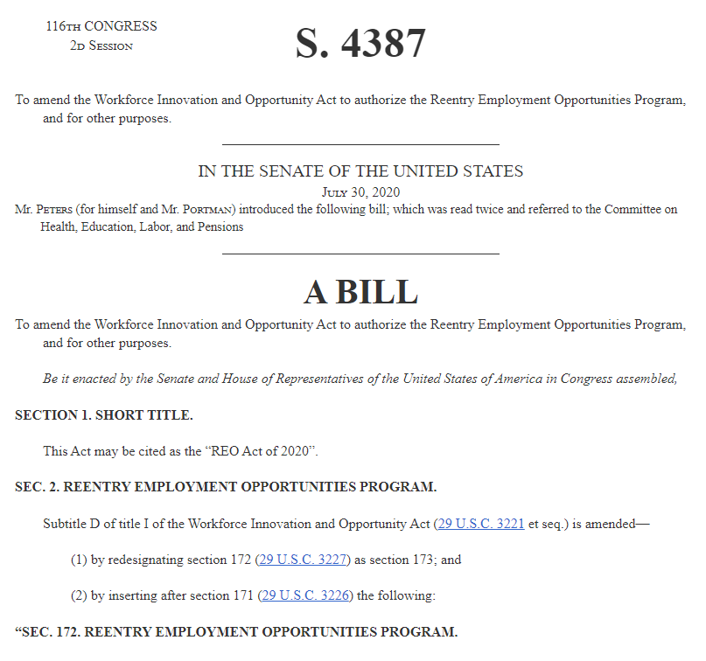
Congressional Activity: REO Codification
Reentry Employment Opportunities Act of 2020 (Senate Bill 4387)
Workforce Innovation and Opportunity Act of 2022 (House Bill 7309)

Slide 24
Question 1:
Eligibility: If REO were to be codified, should participant eligibility be expanded to better align with program needs? If so, what populations should be included that are currently excluded?

Slide 25
Question 2:
Funding & Data: What criteria should be used to determine the level of formula funding that is made available to communities? What data sources would be most helpful in determining the scope of need in a community?

Slide 26
Question 3:
Anti-Carceral Policy Design: How can policymakers improve the REO program design to ensure that dollars are used to reduce the carceral footprint in communities of color, rather than expand the scope of corrections and law enforcement in those communities?

Slide 27
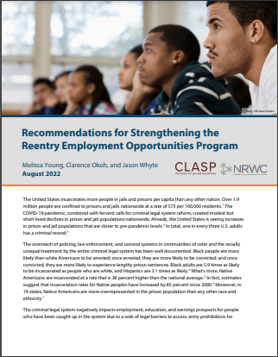
Resources
Relocating Reentry: Divesting from Community Supervision, Investing in “Community Repair” https://www.clasp.org/publications/report/brief/relocating-reentry-divesting-from-community-supervision-investing-in-community-repair/
Recommendations for Strengthening the Reentry Employment Opportunities Program https://www.clasp.org/publications/report/brief/recommendations-for-strengthening-the-reentry-employment-opportunities-program/

Slide 28
Thank You!

Slide 29
Speaker Contact Information
Clarence Okoh | cokoh@clasp.org

