Slide 1
Protecting Immigrant Families
Working Together to Fight the Administration’s Proposed Public Charge Rule Changes
MADISON HARDEE, CENTER FOR LAW AND SOCIAL POLICY
CONNIE CHOI, NATIONAL IMMIGRATION LAW CENTER

Slide 2
BACKGROUND: PUBLIC CHARGE
“Public Charge” is a term used in immigration law to refer to a person who is likely to become primarily dependent on the government for support.
A public charge assessment is made:
When a person applies to enter the U.S. or
Applies to adjust status to become a
Lawful Permanent Resident (LPR), NOT when
applying to become a U.S. citizen

Slide 3
BACKGROUND: PUBLIC CHARGE
Under current policy, only two types of public benefits may be considered:
Cash assistance for income maintenance
Institutionalization for long-term care at government expense

Slide 4
PUBLIC CHARGE FACTORS
Officer to look at applicant’s:
Age
Health
Family status
Financial status
Education and skills
Affidavit of support
Legally enforceable contract that one signs to accept financial responsibility for another person, usually a relative, who is coming to the U.S. to live permanently

Slide 5
THINGS TO KEEP IN MIND
FORWARD-LOOKING
The decision is forward-looking and can’t be based only on what happened in the past.
EXEMPTIONS
Green card holders applying for U.S. citizenship
Refugees and asylees
VAWA self-petitioners, survivors of domestic violence, trafficking, or other serious crimes
Special immigrant juveniles
Certain parolees, and several other categories of non-citizens

Slide 6
RECENT CHANGES: FOREIGN AFFAIRS MANUAL (FAM)

Slide 7
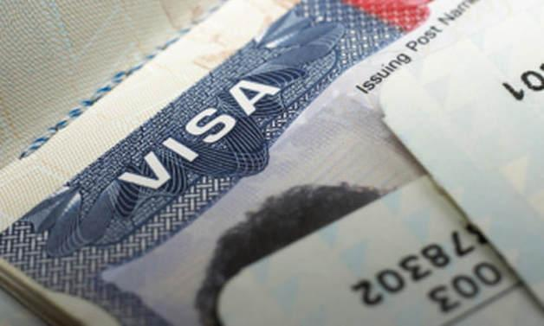
FOREIGN AFFAIRS MANUAL
Officials in consulates abroad use the Department of State’s FAM to make decisions about whether to grant permission to enter the U.S.
Notes:
Officials in U.S. embassies and consulates abroad use the FAM to make decisions about whether to grant non–U.S. citizens permission to enter the U.S.
The revised State Department instructions continue to require that each factor (age, health, income, education, family situation, etc.) be considered in the public charge test. However, the instructions also include changes in evaluating a sponsor’s affidavit of support and the use of noncash benefits by applicants, sponsors, and family members.
The revised State Department instructions continue to require that each factor (age, health, income, education, family situation, etc.) be considered in the public charge test. However, the instructions also include changes in evaluating a sponsor’s affidavit of support and the use of noncash benefits by applicants, sponsors, and family members.

Slide 8
FOREIGN AFFAIRS MANUAL (FAM) CHANGES
Revisions to FAM instructions (Jan. 2018). Public charge definition not changed, but:
Affidavit of support is not enough on its own
Look to applicant’s age, health, family status, financial resources, skills
Use of non-cash benefits may be considered as part of “totality of circumstances”
May consider benefits used by sponsors or family members
NOTE: Affects only decisions made by consular officials abroad
Notes:
Officials in U.S. embassies and consulates abroad use the FAM to make decisions about whether to grant non–U.S. citizens permission to enter the U.S.
The revised State Department instructions continue to require that each factor (age, health, income, education, family situation, etc.) be considered in the public charge test. However, the instructions also include changes in evaluating a sponsor’s affidavit of support and the use of noncash benefits by applicants, sponsors, and family members.
The revised State Department instructions continue to require that each factor (age, health, income, education, family situation, etc.) be considered in the public charge test. However, the instructions also include changes in evaluating a sponsor’s affidavit of support and the use of noncash benefits by applicants, sponsors, and family members.

Slide 9
FOREIGN AFFAIRS MANUAL (FAM) CHANGES
Current and potential impact of the FAM guidance
Growing numbers of reports of denials or requests for additional evidence
More scrutiny of affidavits of support by joint sponsors
Applicants refused if unemployable, retired, and/or disabled.
Limitations on harm
Forms have NOT changed
Practically, difficult to find out about use of public benefits by family members in U.S.
Consular officers still have discretion – practices varies from place to place
Notes:
FAM could be revised again, e.g. if policy for officials in US changes
We are monitoring this – please let us know what you hear!

Slide 10
PUBLIC CHARGE: NOTICE OF PROPOSED RULEMAKING (NPRM)

Slide 11
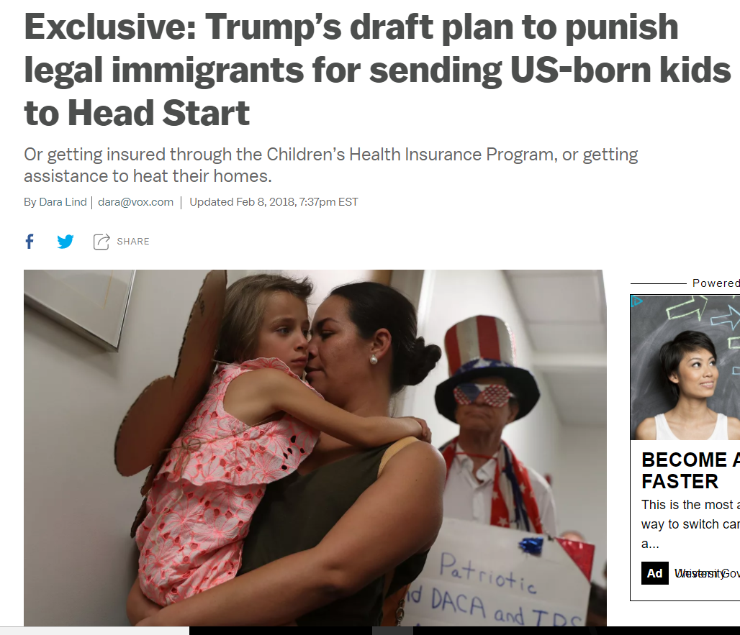
PUBLIC CHARGE PROPOSED RULE
DRAFT Notice of Proposed Rulemaking (NPRM)...
leaked to the press in February and March of 2018
Notes:
Draft leaked in Washington Post (3/28/18).
Children in immigrant families are a large and growing share of the U.S. young child population—about one in four young children live with one or more parents who are foreign-born
In CLASP’s field research, we learned that immigrant families are increasingly turning to their home visitors or family engagement staff at their child’s child care or preschool program with questions about immigration policy changes and their eligibility for public benefit programs.

Slide 12
DRAFT PROPOSED RULE: CONTENT
DHS/USCIS allowed to consider a much broader array of services and benefits in the public charge determination, including:
Health programs like non-emergency Medicaid, CHIP, and ACA Marketplace subsidies/tax credits
Nutrition programs like SNAP and WIC
Housing assistance
Energy assistance (LIHEAP)
Earned Income Tax Credit (EITC)
Comparable State & Local Programs
Benefits received by dependents – including U.S. citizen children – may be considered

Slide 13
DRAFT PROPOSED RULE: CONTENT
Certain benefits specifically exempt
Retirement, Survivors, and Disability Insurance (RSDI)
Veteran’s benefits
Unemployment
Worker’s comp
Medicare
In-state tuition and gov’t loans that require repayment
Emergency and disaster assistance
Benefits not enumerated as included/excluded could potentially be included if “targeted to low-income people” or that “helps participants meet basic needs”

Slide 14
DRAFT PROPOSED RULE: CONTENT
Revised definition of “public charge”
Current: “An alien who is likely to become primarily dependent on the Government for subsistence.”
Draft proposed: “An alien who is likely at any time to use or receive one or more public benefits.”

Slide 15
DRAFT PROPOSED RULE: CONTENT
Rule not retroactive
Noncash benefits used before public charge rule is finalized are not likely to be used as a factor in a public charge determination for an individual or family member.
Certain heavily weighted factors
Positive – Includes being of employable age and/or working with income and assets of at least 250% FPL
Negative – Includes receiving public benefits for a total of more than 6 months during the 2 years before seeking admission or LPR status

Slide 16
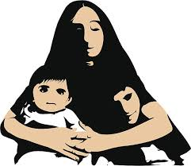
EXAMPLE: ANGIE
Angie is a 32-year-old single mother with 3 children. She wants to become a lawful permanent resident (green card holder)
Sister sponsored her to come to the U.S.
Recently completed her nursing degree and is working for a hospital
Has ACA coverage with tax credits
U.S. Citizen Kids are covered under Medi-Cal and get SNAP (food stamps)
The father of her children is not working

Slide 17
EXAMPLE: ANGIE
Negative factors
Supports a large family
Low income
Receives subsidized health insurance
Children received Medi-Cal and SNAP
Positive Factors
Working age
Good health
Has a job
Skills are in demand
Has a sponsor

Slide 18
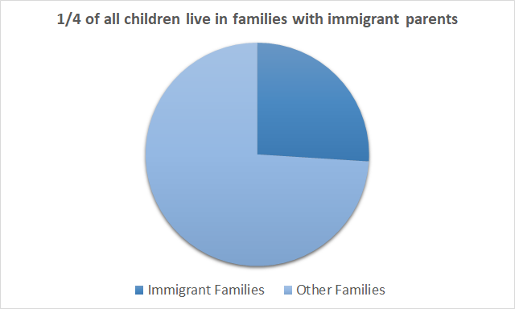
PROPOSED RULE: IMPACT
“The action has the potential to erode family stability and decrease disposable income of families and children because the action provides a strong disincentive for the receipt or use of public benefits by aliens, as well as their household members, including U.S. children.”

Slide 19
PROPOSED RULE: TIMELINE
Fall 2017 → Unified Agenda lists NPRM published by July 2018
1
March 2018 → Draft rule went to Office of Management and Budget
2
Any day → Proposed rule (NPRM) published in Federal Register
3
Opportunity for Public Comment (60 days likely)
4
Final rule published
5

Slide 20
PUBLIC CHARGE: MESSAGING AND FIGHTING BACK

Slide 21
PUBLIC MESSAGING
How you live your life and contribute to your community should define you in this country, not how you look or how much money you have.
Trump proposal makes immigration a pay-to-play game, putting the wealthy ahead of families who’ve waited years to be reunited.
But, by forcing families to choose between reuniting with their loved ones and weathering tough times, it would make the U.S. a sicker, hungrier, poorer nation.
We’ve seen abuses like this before in our immigration history, against Jews and Irish and Italian Catholics.

Slide 22
MESSAGING TO FAMILIES
The rules for immigrants who apply for a green card in the U.S. (who are not processed abroad) have not changed. Receipt of non-cash public benefits for which you are eligible currently are not considered when you obtain a green card in the U.S.
Public charge test considers totality of the circumstances.
-- Families need to make individual determinations
-- Using health care and nutrition benefits can help
you be stronger and healthier
For individuals currently receiving public assistance, there may be no advantage to terminating benefits at this time
Many families are not subject to public charge

Slide 23
STRATEGIES TO RESPOND
EDUCATE immigrant families to fight the chilling effect
TALK TO policymakers to urge them to oppose the changes
SUBMIT public comments in opposition
Organizational comments
Individual comments
DOCUMENT the harm and identify individuals/families who may be willing to share their story publicly

Slide 24
PROTECTING IMMIGRANT FAMILIES,
ADVANCING OUR FUTURE:
THE CAMPAIGN

Slide 25
www.protectingimmigrantfamilies.org

Slide 26
WHAT YOU CAN DO: BEFORE NPRM IS PUBLISHED
Educate partners about public charge policy and the need to push back
Add an agenda item to a standing meeting or call
Ask them to sign up for PIF Campaign email list to get updates on policy developments
Plan outreach and comment strategy for rule publication
Who will draft rapid response email when rule is published? Press release?
Who will adapt template comments? Plan educational events?
Who will answer policy questions from partners?

Slide 27
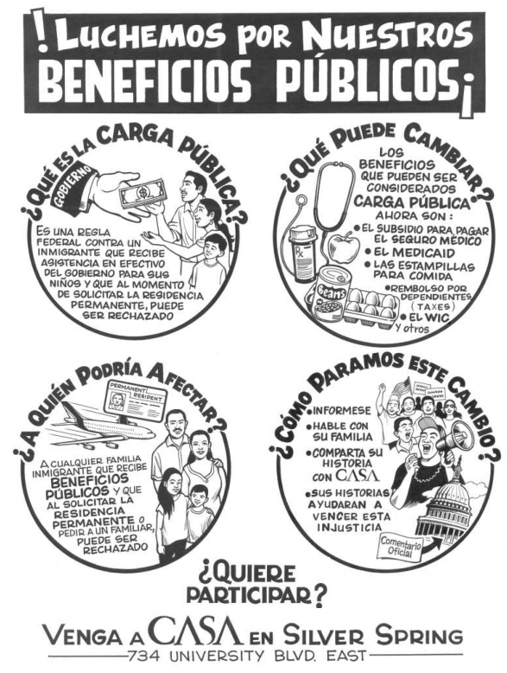
WHAT YOU CAN DO: AFTER NPRM IS PUBLISHED
COMMENT!
Adapt template comments for your state
Community Education
Develop & share resources w/ partners
Engage Newspaper, Radio & TV Media
Hold community meetings
Use social media
#ProtectFamilies
#OurAmericanStory

Slide 28
Questions??

