Slide 1

Improving Access, Cutting Red Tape: State Lessons from Work Support Strategies
A webinar from:
The National Collaborative for Integration of Health and Human Services at APHSA, and
The Center for Law and Social Policy (CLASP)
June 12, 2017

Slide 2




Speakers
Judy Lawrence, Operational Support Team Representative, North Carolina Division of Health and Human Services,
judy.lawrence@dhhs.nc.gov
Greg Kunz, Deputy Administrator, Idaho Department of Health and Welfare, Division of Welfare/Self Reliance Programs, Greg.Kunz@dhw.idaho.gov
Megan Lape, Director, National Collaborative for Integration of Health & Human Services, APHSA, mlape@aphsa.org
Elizabeth Lower-Basch, Director, Income and Work Supports, CLASP,
elowerbasch@clasp.org

Slide 3
Poll
Where do you work?
State health or human services agency
Other public agency
Service provider
Advocacy organization
Other

Slide 4
APHSA’s Vision
Strengthen our country’s human-serving eco-system to provide:
Client-centric, modern marketplace experience
Designed to improve individual and population well-being
Bend the cost curve
Use seamless information exchanges, shared services, flexible payment models and coordinated care
Focus on outcomes rather than outputs.

Slide 5
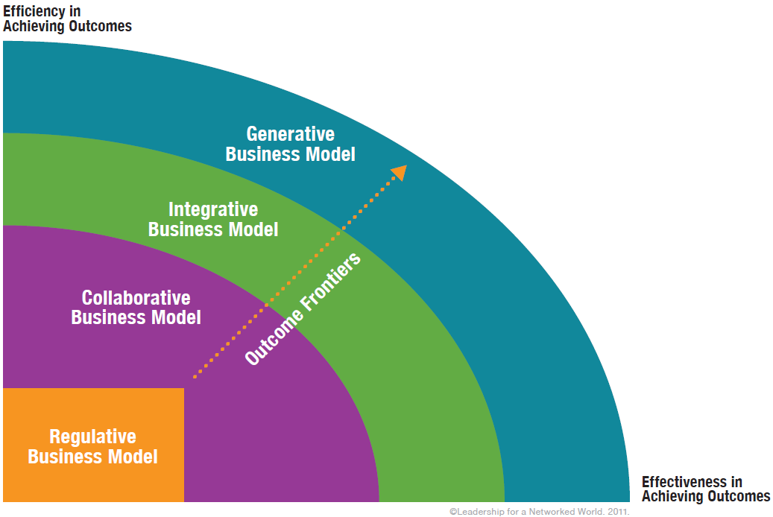
A Roadmap for Integration
Human Services Value Curve
Key Features of H/HS
Integration Business Model
Vision
Governance
Adaptive Leadership &Capabilities
Access Channels & Engagement
Common Process Functions
Coordinated Service Delivery
Defining Success
Measures
Infrastructure
Financing

Slide 6
2015 H/HS Integration
Self-Assessment Findings
Human Services Value Curve
  Highest Ranked Features:
  Adaptive Leadership/Responsiveness to Change
  Governance/Decision-Making
  Vision/Strategic Focus
  Outcomes/Defining Success
  Consumer Access

Slide 7
2015 H/HS Integration
Self-Assessment Findings
Human Services Value Curve
  Lowest Ranked Features:
  Use of Technology
  Use of Data
  Workflows
  E&E Common Processes/Shared Services
  Coordinated Service Delivery/Role of Front-Line Worker

Slide 8
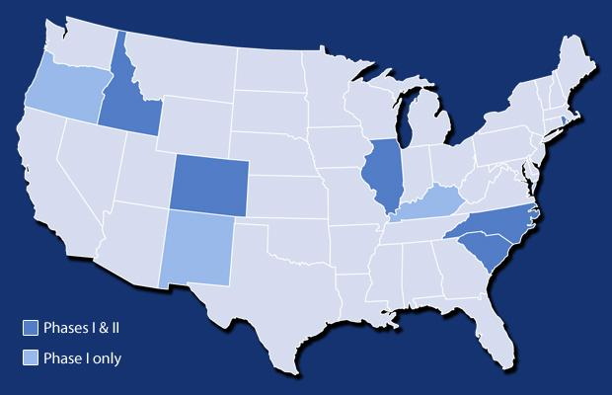
Work Support Strategies
Colorado
Idaho
Illinois
North Carolina
South Carolina
Rhode Island

Slide 9

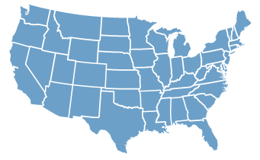

WSS Goals
Improve families’ wellbeing by increasing enrollment in the full package of work supports.
Help states deliver benefits more effectively and efficiently
Share lessons learned to inform state and federal policies.

Slide 10
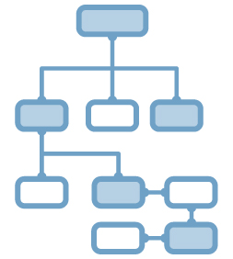




Multiple Strategies Needed
Business Processes
Technology & information systems
Data analysis and use
Management & Communication
Policy

Slide 11
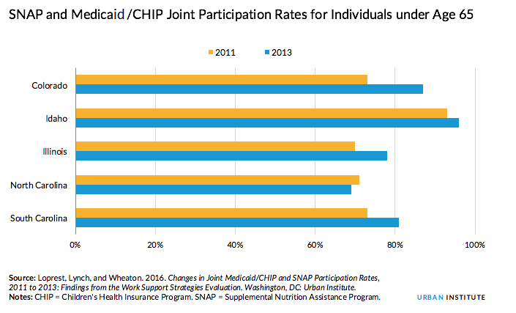
Increased Joint Participation

Slide 12
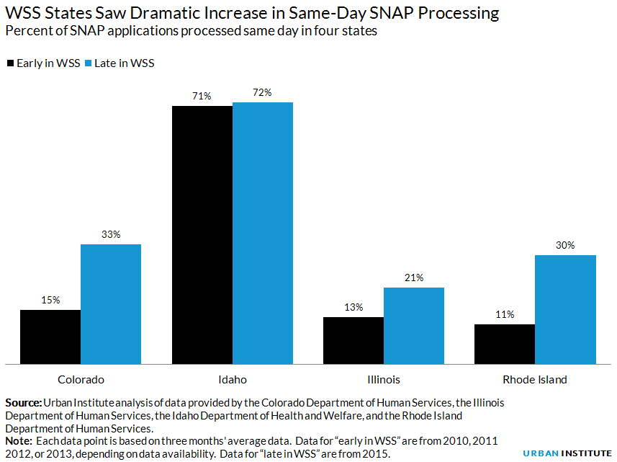
Increased Same Day Service

Slide 13
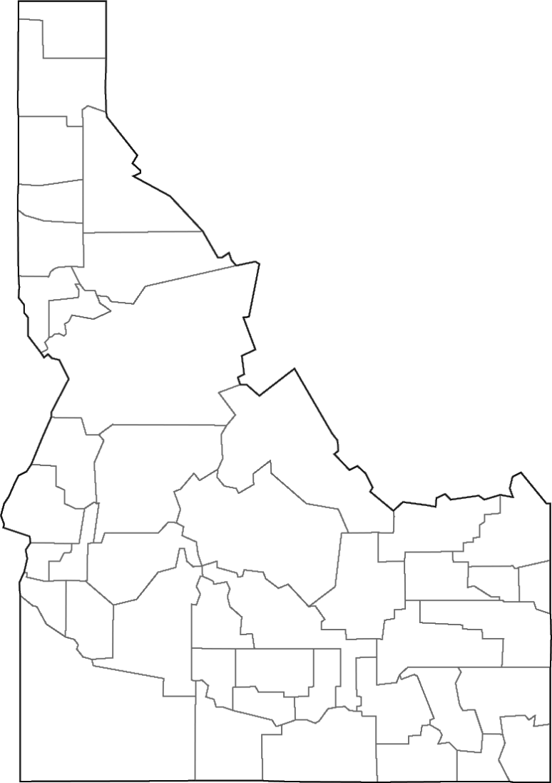
Creating Integrated Business Systems to support Idaho Families
11 years & 6 lessons
since 2006
Lori Wolff & Greg Kunz
Revised from NGA Salt Lake City 2016

Slide 14
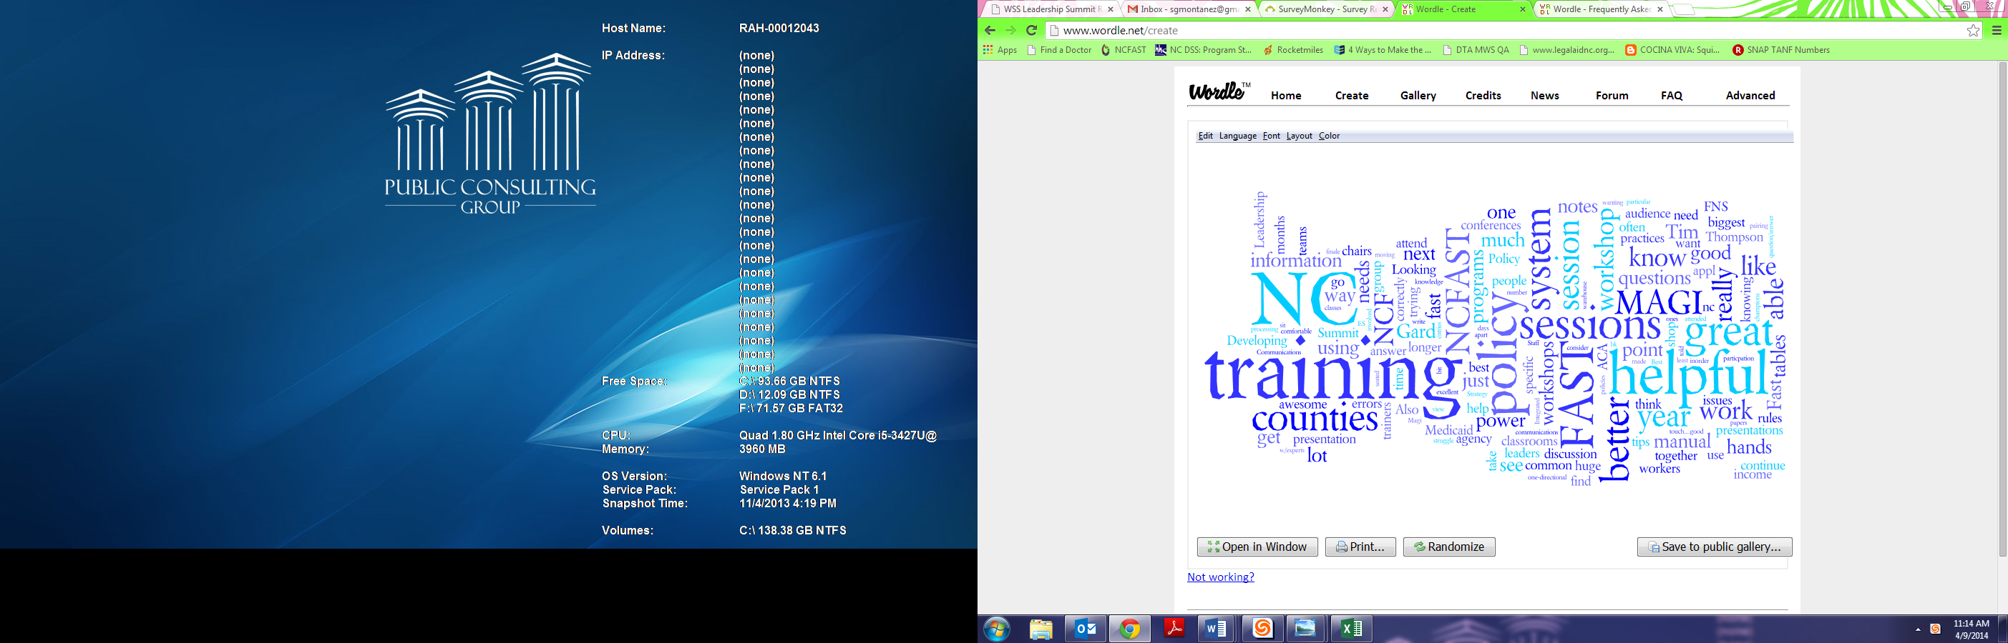
North Carolina Department of Health and Human Services:
Work Support Strategies

Slide 16
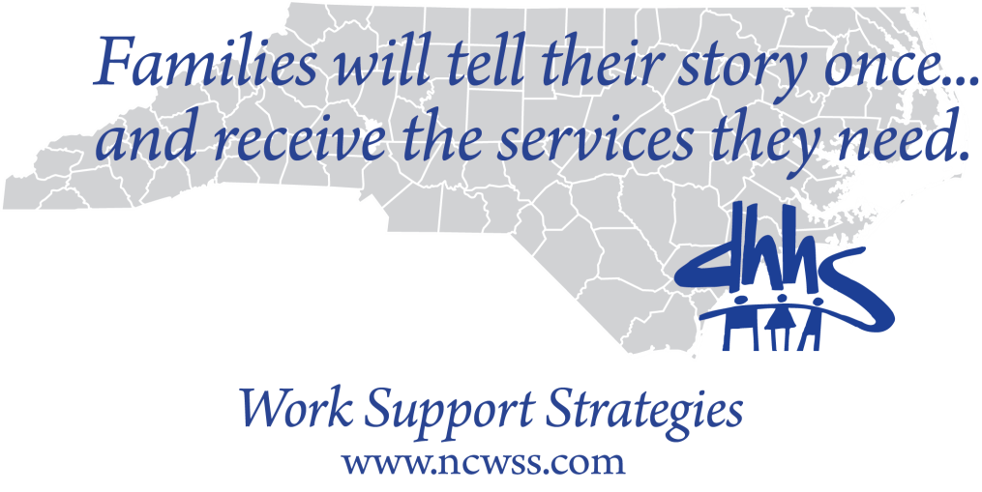

Slide 17




6. It’s about the Family
Discover
Connect
Empower
De-stigmatize
Online & in office
…to live better
  Google: Live Better Idaho
  www.livebetteridaho.org
17

Slide 18
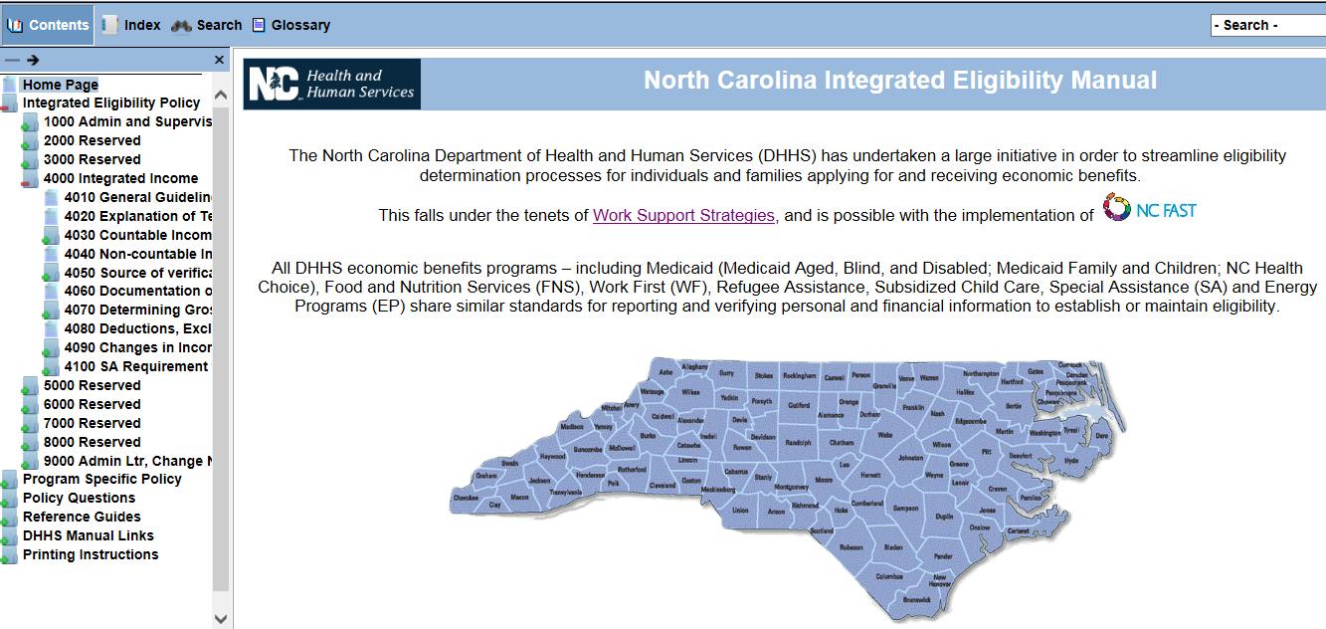

Slide 19
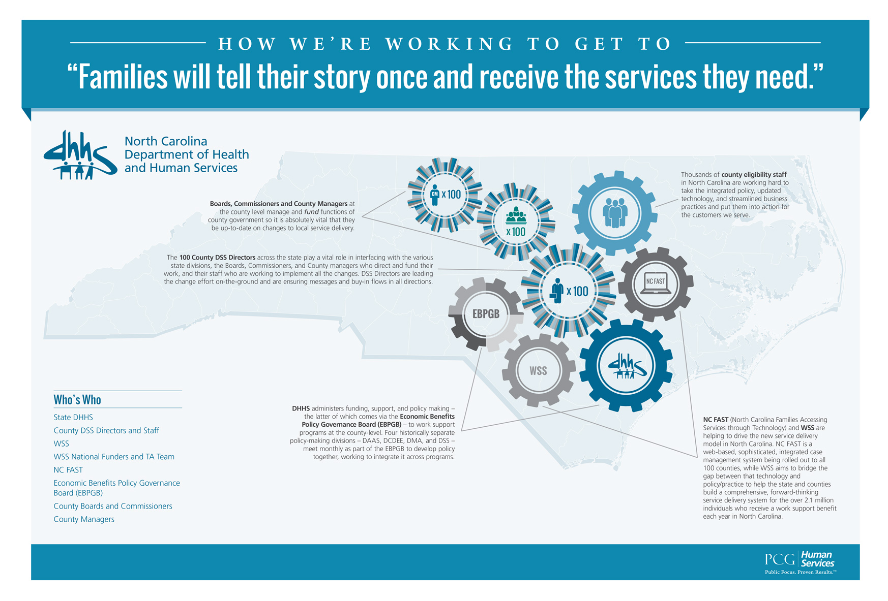

Slide 20
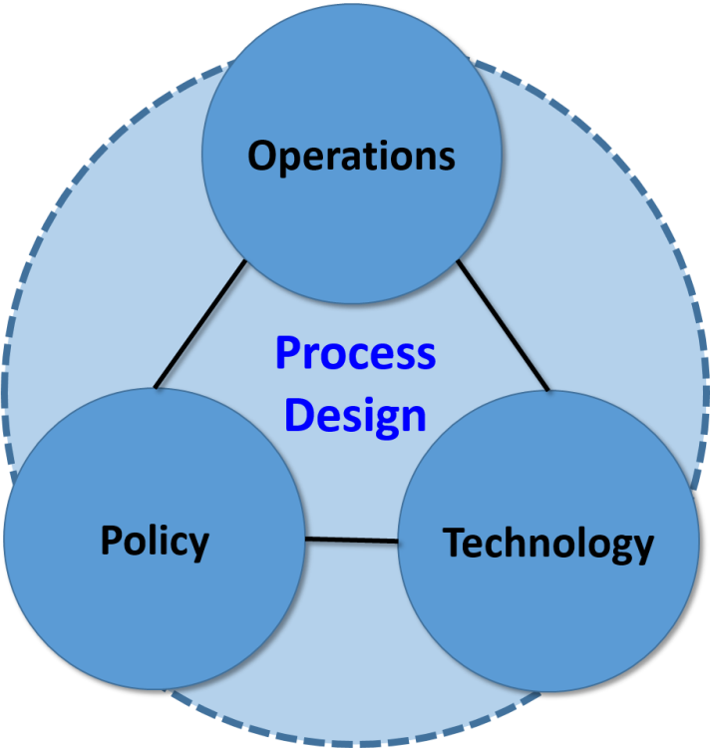
2. Business Design: Operations/Process Engineering
Process, not technology, must be the focus
Does it work for the family? (customer centric)
Fail small and often
Connect families to services - not programs
Don’t pass decisions - one contact
New people and new skill sets
It’s not what you know, its what you can learn!
It’s a cultural thing…not just words, ACTIONS
20

Slide 21
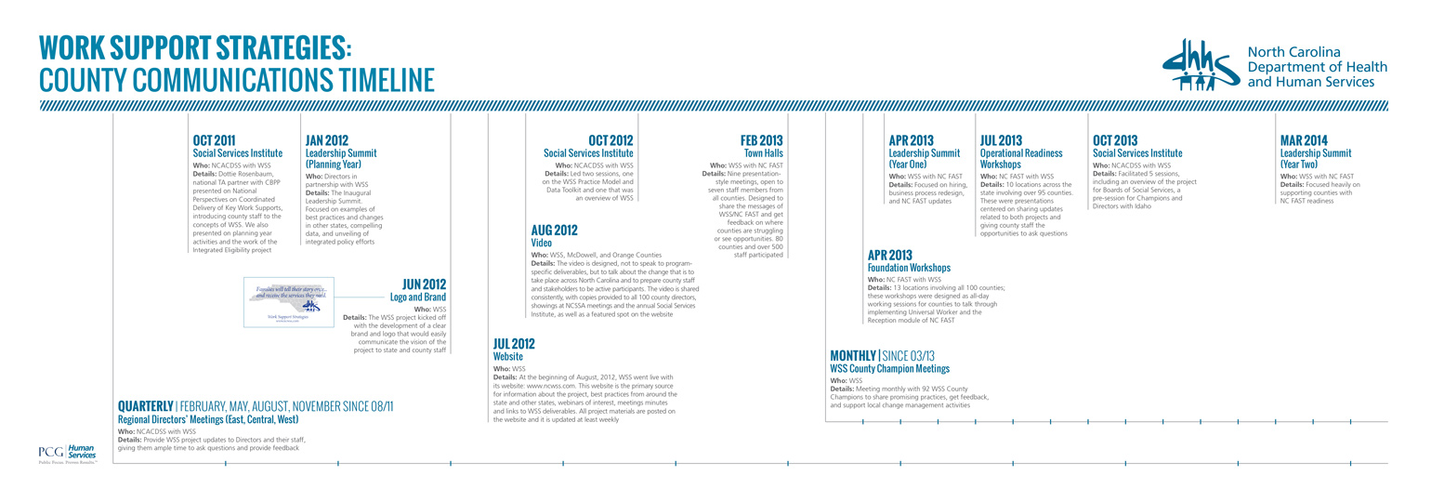

Slide 22
1. Know the customer (SNAP just one example)
13 month average participation
75% of customers only receive benefits for 1 or 2 spells
Many customers have either sporadic employment or low wages
Only 4% receive benefits continuously: single moms, single elderly woman, large families with both parents working, and families with disabled household member(s)
75% 1 or 2 times (crisis)
16% 3 or more times
Off SNAP
On SNAP
5% Long period participation
4% Continuous participation
Other examples:
Application preferences
Re-evals and Churn
Single point resolution
Access to other service partners
22

Slide 23
Q&A

Slide 24

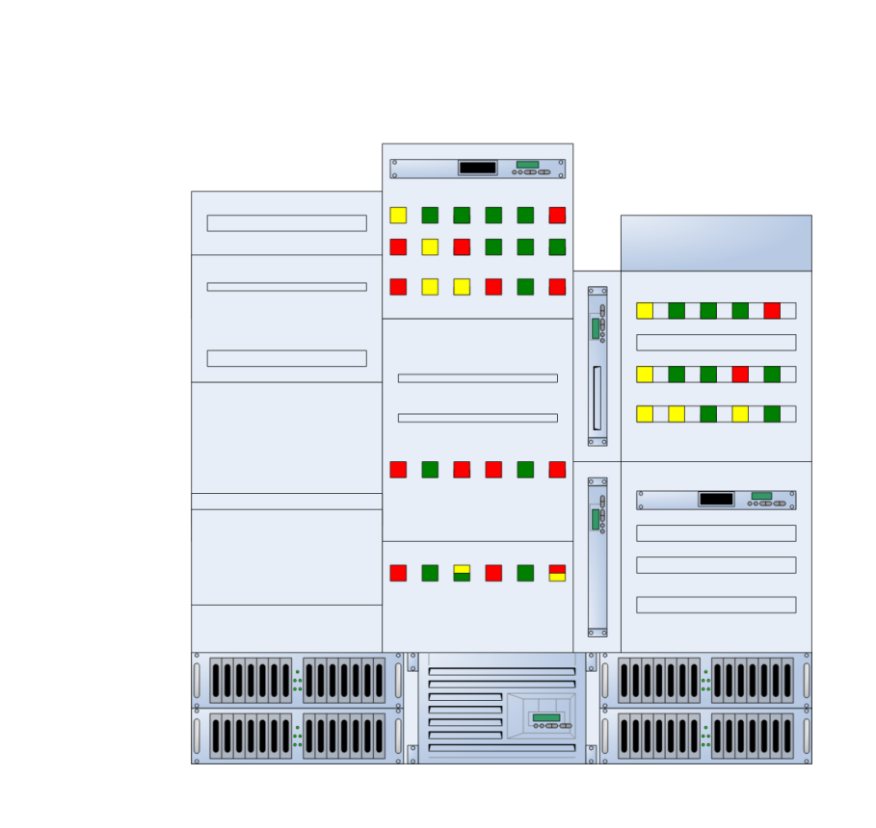
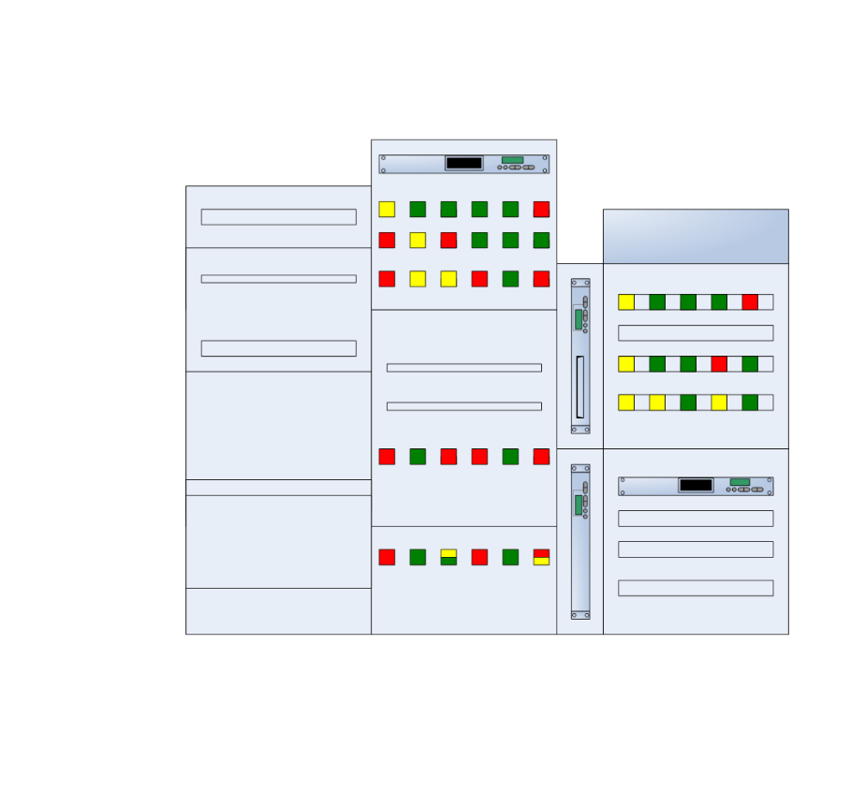
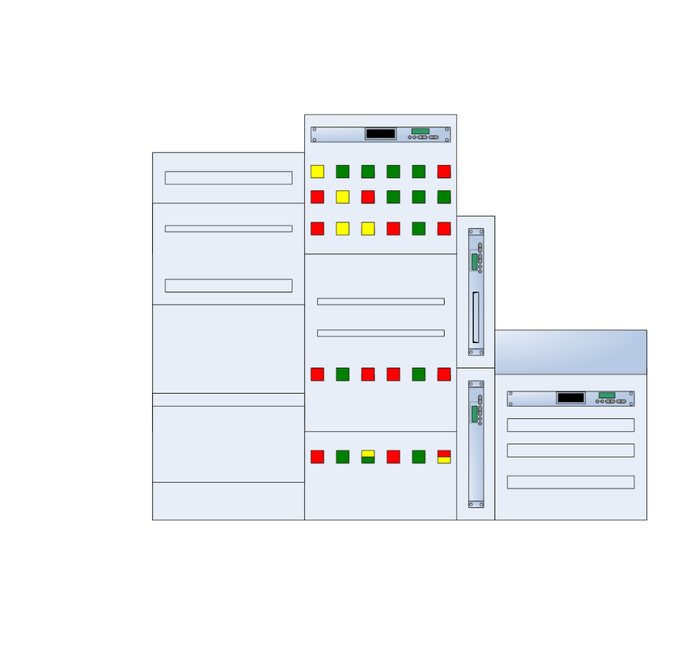
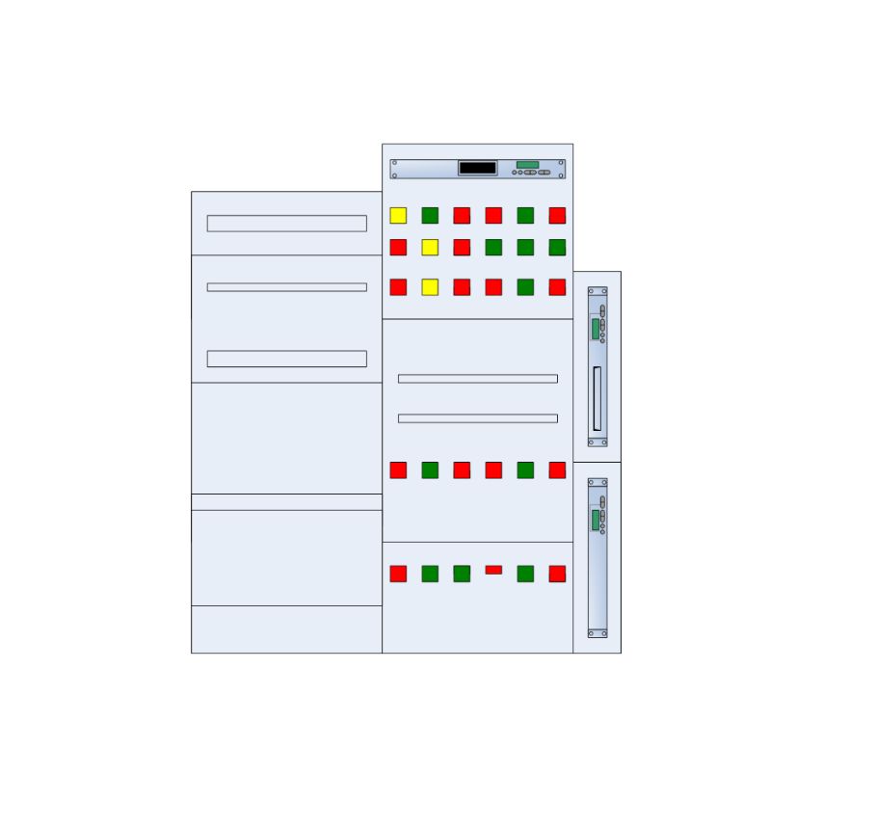
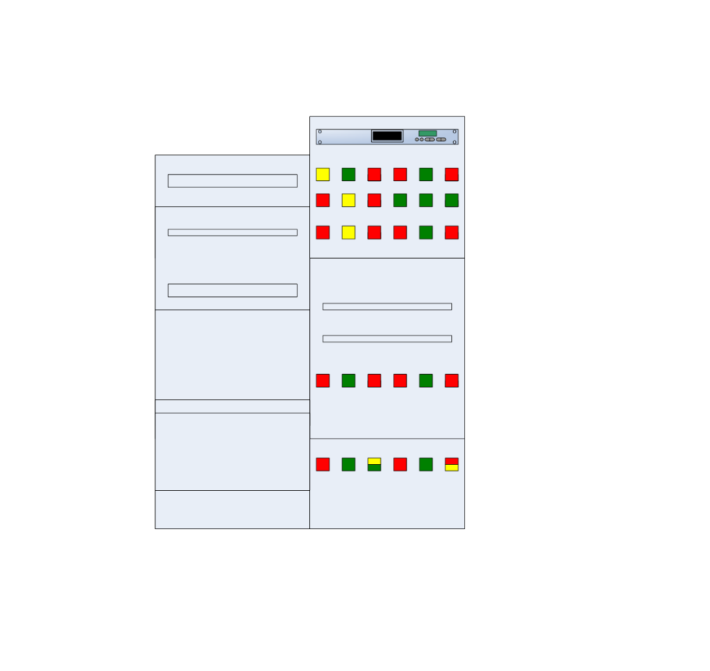

4. Technology: right time and right place
Does NOT solve problems!
When it’s the right tool
Right size functionality (small)
Agile software development
Incremental deployments
Business responsibility
Business/IT partnership
24

Slide 25

5. Funding: Finance Strategies
Know the Budget
Finance Integration
Understand Cost Allocation
Maximize Existing Cost Allocation
Intelligent 90/10 Funding
New 90/10 Environment
Prepare for financing changes
Explore Strategies
FNS
CMS 90/10
Cost Allocation
Plan
CMS 75%
ACF
$
Private
Awards
State
Block Grants
Other
25

Slide 26















3. Workforce: Adaptable & General
Any worker
Any location
Any phone
Any lobby
Any service
Right tools
One training
Real Time Decisions
Real Time Service Delivery
Real Time
Notification
Self Service
Portal
Real Time Reconciliation
Phone
Verifications
Virtual
Decision Maker
Eligibility Logic
Immediate
Contact
REAL
TIME
Immediate
Resolution
Interfaces
Individual Contacts
Federal & State
Data bases
Immediate Contact
Applicants
Re-applicants
Face-to-Face ● By Phone ● On the Web
Decision Maker
Universal Workforce
26

Slide 27
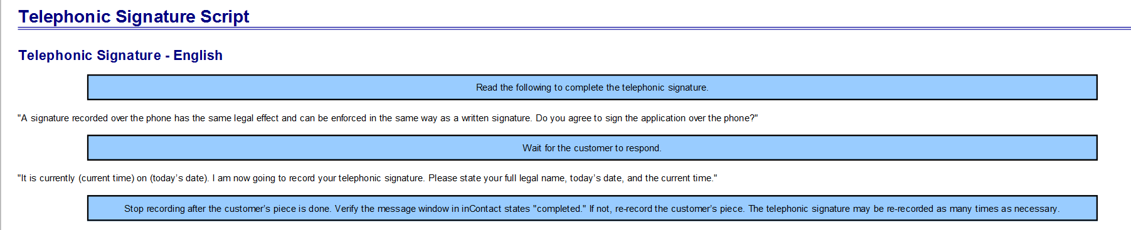
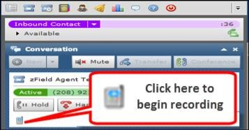
One more thing…Telephonic Signature
Staff read a script to the customers explaining the telephonic signature process
Staff press the ‘record’ button in the inContact platform while customers speak their name and the day’s date and time
Read the following to complete the telephonic signature.
“A signature recorded over the phone has the same legal effect and can be enforced…”
inContact is a contracted cloud-based ACD service that allows all staff throughout Idaho to place, take, and transfer calls to customers, 3rd parties, and other state staff anywhere in the state – telephonic signatures (.WAV) are stored and linked to the application or case in the case management system
27

Slide 28
Resources
The Human Services Value Curve. Antonio M. Oftelie. The Pursuit of Outcomes: Leadership Lessons and Insights on Transforming Human Services: A Report from the 2011 Human Services Summit on the Campus of Harvard University. Leadership for a Networked World. 2011.
2015 H/HS Integration Self-Assessment Findings. http://www.aphsa.org/content/dam/aphsa/pdfs/NWI/2015%20APHSA%20On%20the%20Road%20to%20Horizontal%20Integration.pdf
Work Support Strategies: www.clasp.org/wss
North Carolina WSS site: http://www.ncwss.com/
Integrated Eligibility Manual, North Carolina Department of Health and Human Services: https://economicbenefits.nc.gov/
Telephonic signatures: SNAP Telephonic Signature Guidance, and Accepting SNAP Applicant and Client Signatures Electronically.

