Slide 1
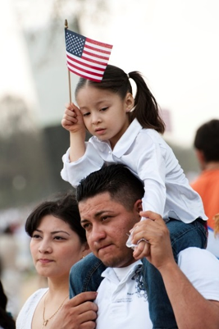
Trauma and Resilience:
Supporting Immigrant Children, Their Families, and Our Communities through Collaboration
June 15, 2017
Wendy Cervantes, Senior Policy Analyst, CLASP

Slide 2
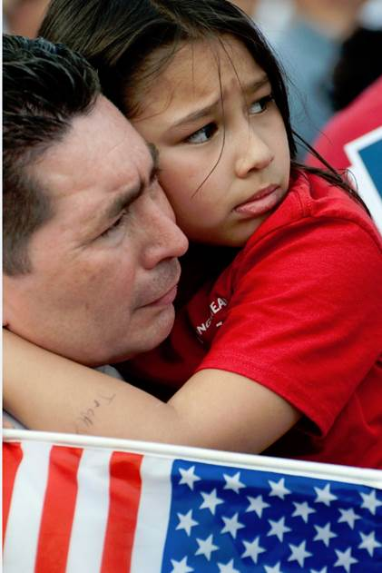
How Anti-Immigrant Policies Impact Children’s Mental Health
Stress related to unauthorized status (parent, youth, or child)
Immigration enforcement/family separation
Policies that fail to meet the needs of unaccompanied & other asylum-seeking children
Policies that restrict immigrant and their families’ access to critical health and nutrition assistance, education, and income supports, including leaked “public charge” EO

Slide 3
Immigration EOs: Key Policy Changes Impacting Children
Anyone without authorization now a priority for deportation, including parents & legal guardians of U.S. citizen children
Massive increase in immigration enforcement
Increased involvement of police in immigration enforcement
Faster deportations for certain immigrants
Weakened protections for unaccompanied children

Slide 4
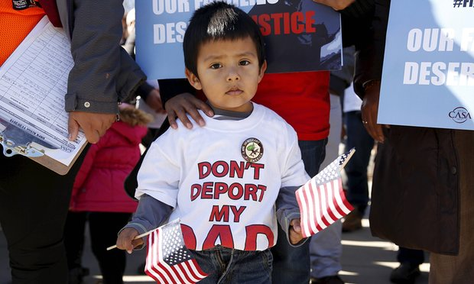
Impact on U.S. Citizen Children in Mixed-Status Families
More than 5 million children in the U.S. live in a mixed-status family with unauthorized parents, and 4.1 million are U.S. citizens
Increased risk of losing a parent to deportation
Toxic stress associated with fear of enforcement
Restricted access to health care, nutrition assistance,
and other critical programs
Anti-immigrant climate in
schools and communities

Slide 5
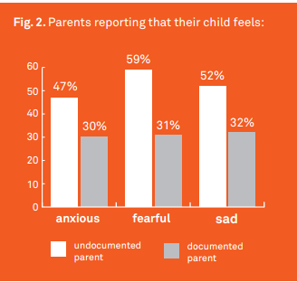
Fear of immigration enforcement harms a child’s mental health
Source: Sara Satinsky, Alice Hu, Jonathan Heller, Lili Farhang, Family Unity, Family Health, Human Impact Partners, 2013.

Slide 6
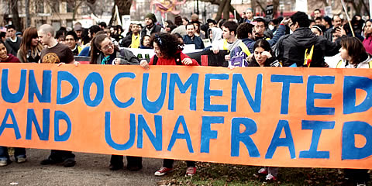
Impact on Dreamers and DACAmented Youth
Less than 1 million
unauthorized children (0-18)
living in the U.S.
More than 787,000
beneficiaries to date
DACA exempt from
January executive orders, but several beneficiaries detained,
and one DACA beneficiary was deported in April
Increased uncertainty and stress for DACA and other Dreamer youth, including threats to Plyler v. Doe implementation

Slide 7
Impact on Unaccompanied Children
More than 68,000 unaccompanied children entered the U.S. in 2014, with high numbers since
Executive orders and federal legislative proposals call for:
weakened protections for unaccompanied children
faster deportations
criminalization of parents
“Trauma upon trauma upon trauma”
(pre-migration trauma, in-transit trauma, post-migration trauma)

Slide 8
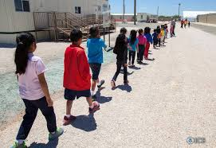
Impact on Accompanied Children
EOs and other policy proposals would put asylum-seeking children and families at greater risk, such as turning them away at the border
Family detention (pilot family case management program terminated)
Children in family detention:
Confused—”We’re not criminals”
Increased depression
Disrupted attachments,
parent-child relationship

Slide 9
Impact on Refugee Children
Reduced capacity/funding of refugee resettlement program
Trump administration challenging Muslim ban injunction
Southern Poverty Law Center school survey on post-election “Trump Effect”:
80 percent report heightened anxiety among marginalized students, including immigrants, Muslims, African Americans, and LGBT students
Forty percent have heard derogatory comments directed at students of color

Slide 10
Resources Needed
Targeted dissemination of safety planning materials to help parents prepare for deportation and how to talk to their children about deportation
Support groups for children and parents in school and community-based settings
Training of educators and service providers on how to identify symptoms of trauma & utilize trauma-informed approaches
Education of stakeholders on the range of policy issues impacting children’s mental health (educators, pediatricians, child care and early education providers, program administrators)

Slide 11
Examples of Resources
CLASP Five Reasons Trump’s Immigration Orders Harm Children
Appleseed Protecting Assets and Child Custody in the Face of Deportation
Women’s Refugee Commission Resources for families facing deportation
American Psychological Association webinar series
AFT “Protecting Our Students” Resources
Department of Education Resource Guide: Building a Bright Future for All
Department of Education Resource Guide: Supporting Undocumented Youth

Slide 12
Contact Info
Wendy D. Cervantes
wcervantes@clasp.org
Office: 202-906-8059
Mobile: 317-627-5593
www.clasp.org

