Slide 1
Elizabeth Lower-Basch
Director
Income and Work Supports
Work Activities and TANF

Slide 2
What is TANF?
Temporary Assistance for Needy Families
TANF Block Grant and MOE
Cash Assistance and Work Activities

Slide 3
TANF: The Block Grant
1996 “welfare reform” replaced AFDC with TANF.
Replaced uncapped matching funds with a fixed block grant ($16.5 billion a year) and maintenance of effort (MOE) requirement for state funds
Block grant and MOE can be used for broad range of benefits and services aimed at 4 purposes of TANF
  TANF funds can also be transferred to CCDBG or SSBG or used for activities authorized under prior law.

Slide 4
Work Explicitly Included in
Four Purposes of TANF
Provide assistance to needy families so that children can be cared for in their own homes or in the homes of relatives;
End dependence of needy parents on government benefits through work, job preparation, and marriage;
Reduce the incidence of out-of-wedlock pregnancies; and
Promote the formation and maintenance of two-parent families.

Slide 5
Work Requirements Apply to Families Receiving Assistance
States must certify in state plan that they impose a work requirement on parents within 24 months and must sanction for non-participation, but have flexibility to define activities, exemptions.
  All states impose participation requirements immediately, or even during the application process
  States must sanction “in proportion” to non-compliance, can include removing adult from grant, but most eventually impose full-family sanctions.

Slide 6
Work Participation Rate
States must meet the work participation rate
  Does not apply to individual recipients, but to a state’s caseload as a whole
  When people say an activity is “not allowed” under TANF, usually mean “not countable toward the WPR”
Two types of countable activities
  Core – primary activities
  Non-core – only countable when combined with 20 hours per week of a core activity

Slide 7
Countable Work Activities
Activity | Time Limits | Counts Toward the WPR | Caps
Unsubsidized employment Subsidized employment On-the-job training Work experience Community service Child care for recipients in community services | None | Yes | None
Vocational education training | Limited to 12 months in a lifetime | Yes | Limited to 30% of counted individuals (along with education for teen parents)
Job skills training Education related to employment Secondary school attendance or GED® classes for recipient without HS degree or equivalent | None | Can only be counted when combined with core activities | None
Job readiness and job search assistance | Limited to 4 consecutive weeks and 6 or 12 weeks total per year | Yes | None

Slide 8
Most States Are Well Under 30% Cap

Slide 9
Hours of Participation
To be counted toward the WPR, recipients must average 30 hours per week of work participation
  Reduced to 20 hours per week if single parent of child under 6
  Higher hours requirement to be counted toward the two-parent rate.
Daily supervision and documentation requirements – must be actual hours of participation, not just scheduled hours.
No partial credit

Slide 10
Target Work Participation Rates
Target rate is officially 50% for all families, 90% for two parent families
But target is reduced due to caseload reduction credit (CRC) for decreases in caseload
States can also get credit toward CRC for spending more MOE than required
About half of states serve no two-parent families in TANF/MOE programs due to separate rate
  Many provide assistance through solely state funded programs; others provide no assistance
Notes:
Note CA, Guam, Maine, Ohio, Oregon and Puerto Rico failed WPR in each of FY 2007-2011.

Slide 11
Work Participation Rate Results
National WPR achieved has been about 30%
  States rates vary widely, but most states have “passed” WPR due to reduced targets
  Number of states “failing” jumped in FY 2008 due to changes made by Deficit Reduction Act of 2005 , but most have adjusted.
6 states, DC, Guam and Puerto Rico failed in FY 2011
  States may enter into “corrective compliance plan” rather than paying the penalties.
Notes:
California, DC, Guam, Maine, Michigan, Missouri, Ohio, Oregon, and Puerto Rico

Slide 12
Why States Care about the WPR
Often treated as primary measure of state TANF performance
States that fail are subject to financial penalties
  up to 5% of block grant for first year of failure, maximum penalty increases by 2% each year.
Even if penalties are waived through corrective compliance, failure results in nasty headlines, Governor is unhappy
Notes:
Advocates need to understand what incentives TANF agencies are facing

Slide 13
Concerns about the WPR
Measure of time in chair – does not measure whether services are effective in helping people achieve self-sufficiency.
Forces caseworkers to focus on documenting participation, rather than on helping families.
Incentivizes caseload reduction
  Caseload reduction credit
  Often easier to remove someone who is not participating from the caseload (and thus from the WPR) than to engage them in countable activities.
Notes:
Even as a measure of engagement, it is hard to interpret, as it is affected by many factors

Slide 14
Concerns about the WPR (2)
Very limited ability to count “barrier removal” activities – mental health, substance abuse treatment.
  Even a few hours of counted participation uses up a week of “job readiness”
Basic education, ESL not countable as a stand-alone activity (except for teen parents)
Full-time vocational education limited to 12 months – often not enough to get a credential leading to a good-paying job.

Slide 15


Slide 16
Reasons for optimism
Many states do not need to worry about the WPR due to caseload reduction credit.
States have other tools they can use to meet WPR, including solely state funded programs and supplemental payment to working families.
Many states are not taking full advantage of the ability to count education and training toward the work rate.
Increased interest in demand-driven job training and work-based learning

Slide 17
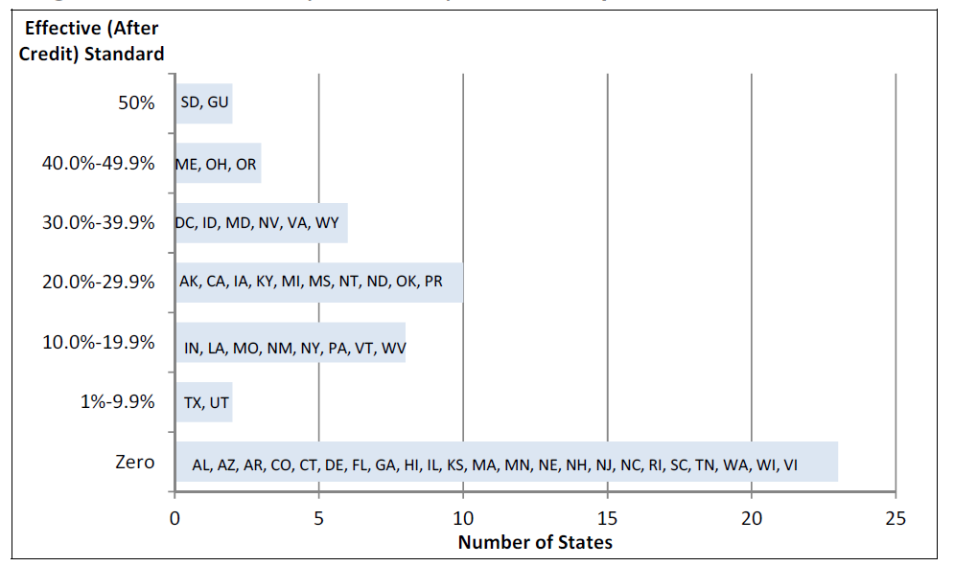
Many States Have Zero Effective
Work Participation Standard
2011 Effective Standards
Notes:
CRS – welfare to work revisited -2011

Slide 18
Strategies for Increasing WPR
Solely state funded programs
  Costs are not claimed as Maintenance of Effort
  Many states serve two parent families, individuals with disabilities, students.
Providing income supplements to low-income working families
  Can be limited to former TANF recipients or broader

Slide 19
States Have Flexibility to Allow More Education and Training
Many states have “work first” approach – job search not education and training
Misconceptions about how restrictive the federal WPR rules are
Belief that education doesn’t work for this population
Inertia -- many states have not changed rules since 1996
  Economy has changed since then
  We know more about effective training programs
Notes:
Federal limits on what can be counted
Concerns about documenting hours

Slide 20
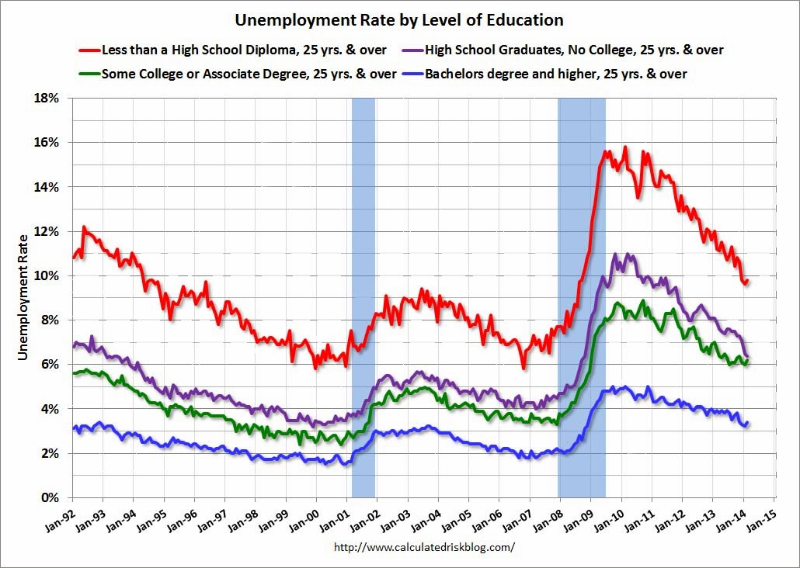
False Choice between Education and Training and Jobs

Slide 21
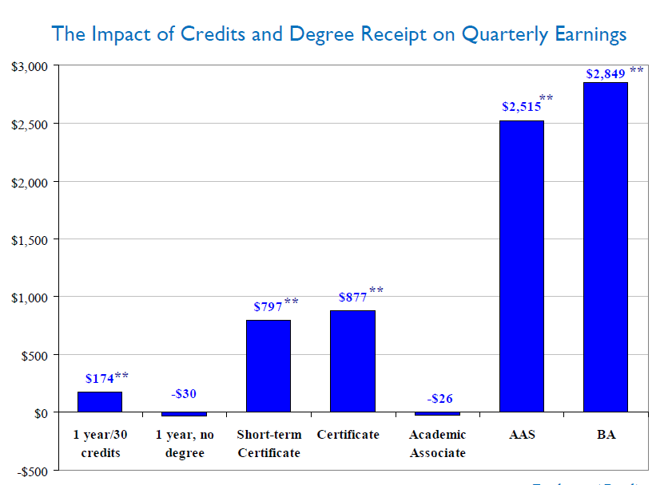
TANF Recipients
Benefit from Degrees
Lesley Turner
The Returns to Higher Education for Welfare Recipients: Evidence from Colorado, 2011
Notes:
Colorado study
Lesley Turner (Columbia University)
The Returns to Higher Education for Welfare Recipients: Evidence from Colorado
Presentation at ACF Welfare Research and Evaluation Conference, June 2011
Please contact the author before reproducing: lesley.turner@gmail.com

Slide 22
Best Practices in Training
High intensity, with clear connection to employment and skills valued by employers
  Focus on credentials with economic payoff
  Even participants with low basic skills start working on vocational skills quickly
  “Stackable” credentials minimize tradeoff between short-term and long-term goals
Addresses students’ overburdened lives
  Supportive services
  Flexible scheduling

Slide 23
Work-Based Learning
Subsidized jobs, on the job training, apprenticeships
Minimizes tradeoff between need to earn wages and skill building
Many states successfully ran subsidized employment programs under the TANF Emergency Fund
Attention from the workforce side

Slide 24

Beyond the WPR:
Work Opportunities

Slide 25

Thank You
For more information:
Elizabeth Lower-Basch
elowerbasch@clasp.org
202 906-8013
www.clasp.org
1200 18th St, NW
Suite 200
Washington, DC 20036

