Slide 1
Building a Vision for Trauma-Informed Policy Making
CLASP Young Adult and Maternal Mental Health Convening
June 18, 2019
Jeff Hild, Redstone Center, GWU School of Public Health
jeffhild@gwu.edu
Learn More: go.gwu.edu/BCR

Slide 2

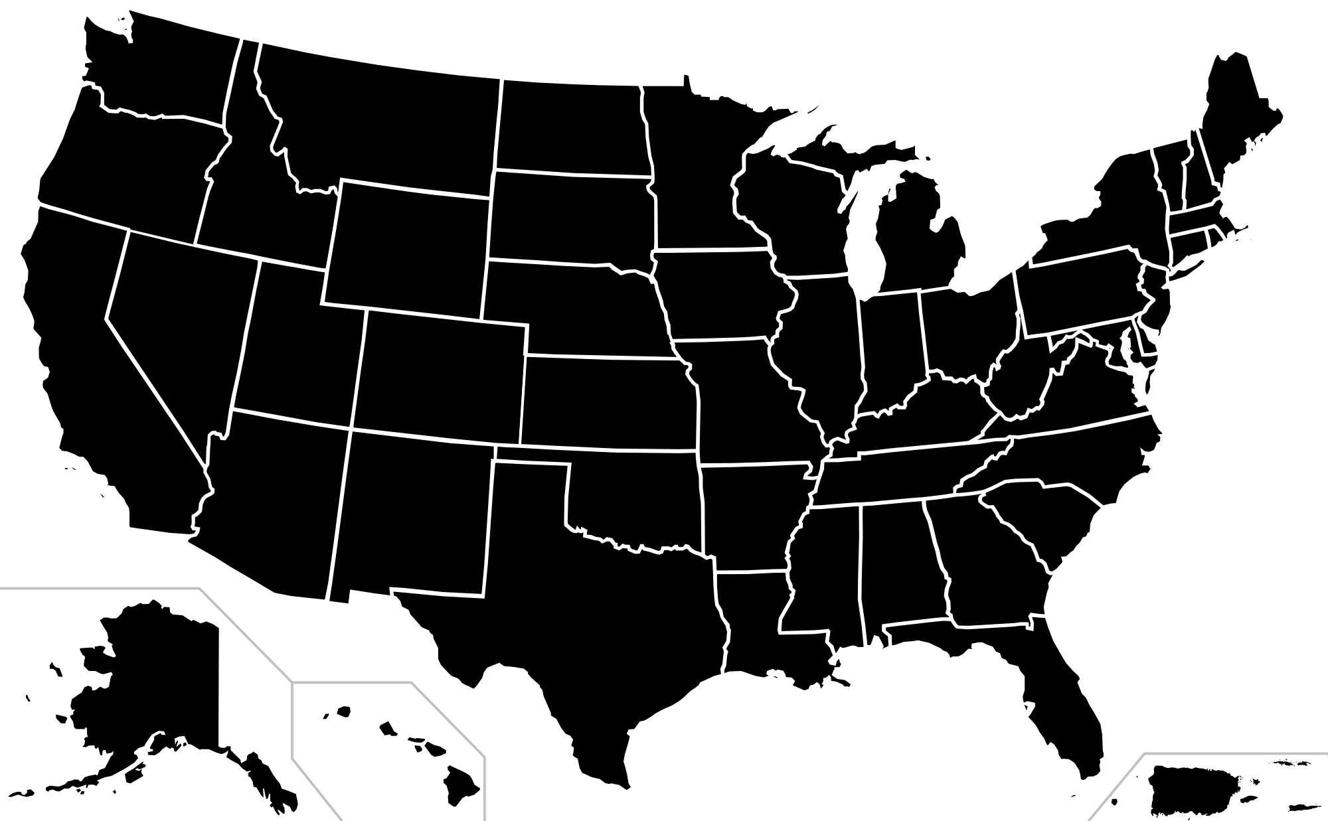




























Oregon
Alive and Well Communities (MO-Kan)
Cincinnati, OH
Washington, DC
Ward 8
Health Council
Dallas, TX

Slide 3
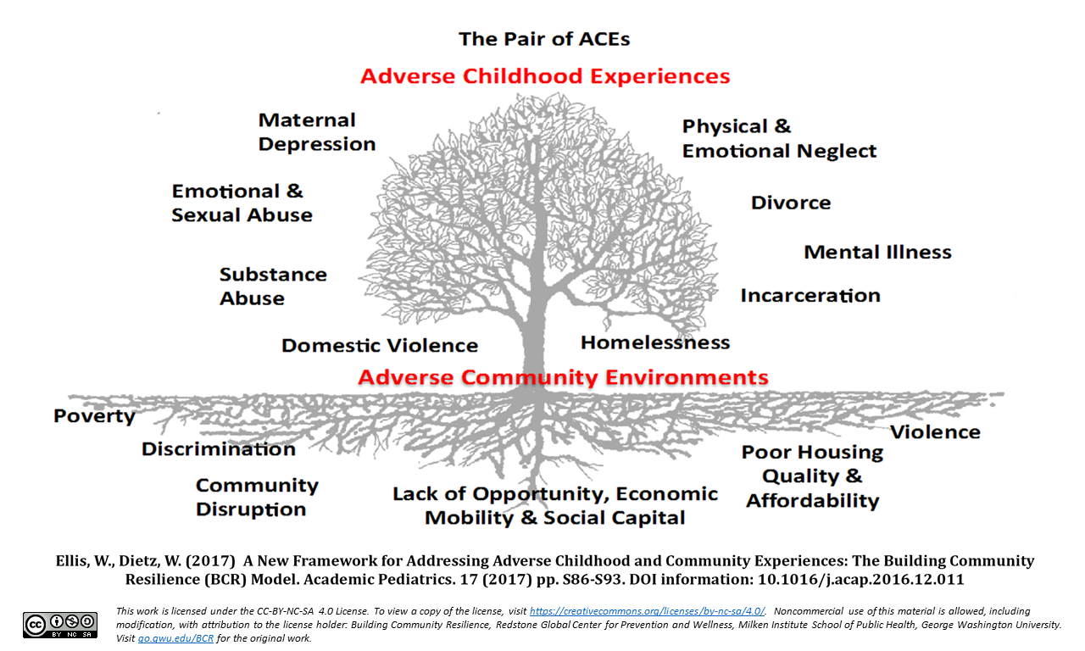

Slide 4
The Power of
Collaboration
Notes:
So here is the BCR model for successful collaboration across sectors. For any public health or collective impact folks, this should look pretty familiar. We start in the upper left with establishing a shared understand. What is our common agenda? Do we have agreed upon definitions. In our case, it starts with defining ACEs, resilience and how those show up in community. Moving over is establishing a state of readiness. Mapping our assets, determining the capacity and capability of various partners, identifying gaps or overlaps and areas of strenght. Next we think deeply about how to connect across sectors. What data are we using, what can we share/ what platforms do we have and what do we need to build? How are resources distributed across our partnerships? Next is the community component….how are we engaging families and community members in a cocreated and collaborative response.

Slide 5
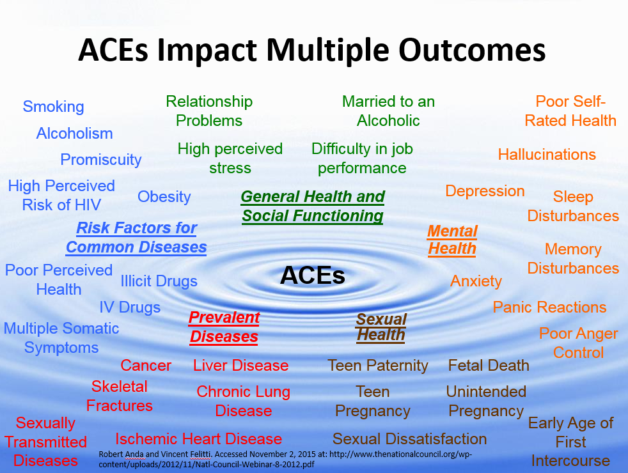

Slide 6
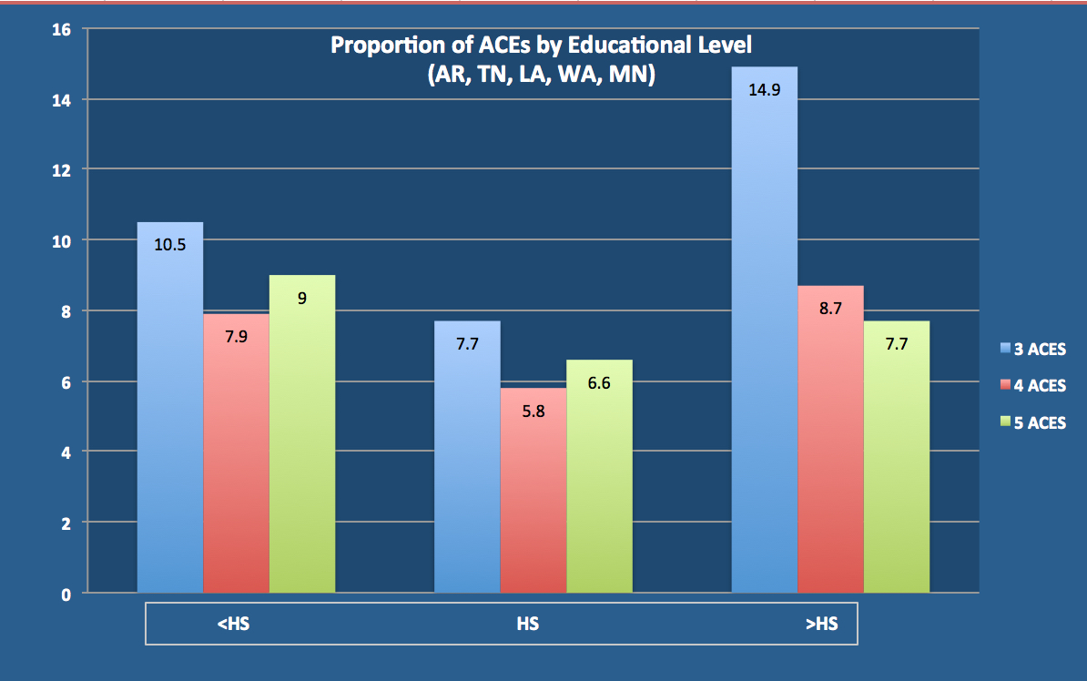
Universality of ACE’s Exposure in the United States

Slide 7
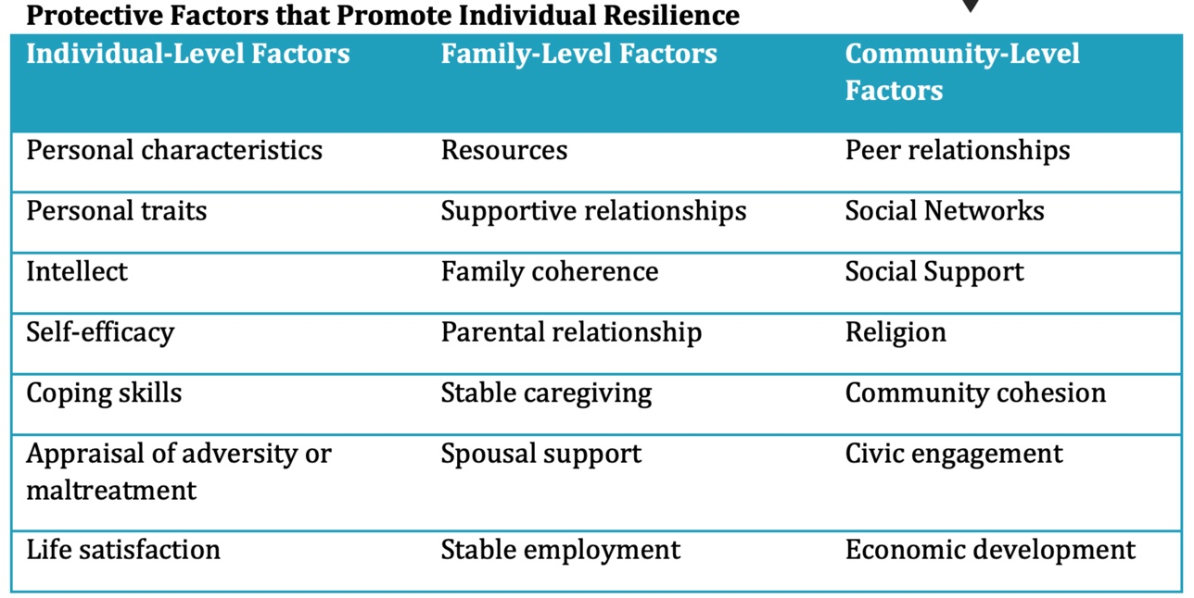

Slide 8
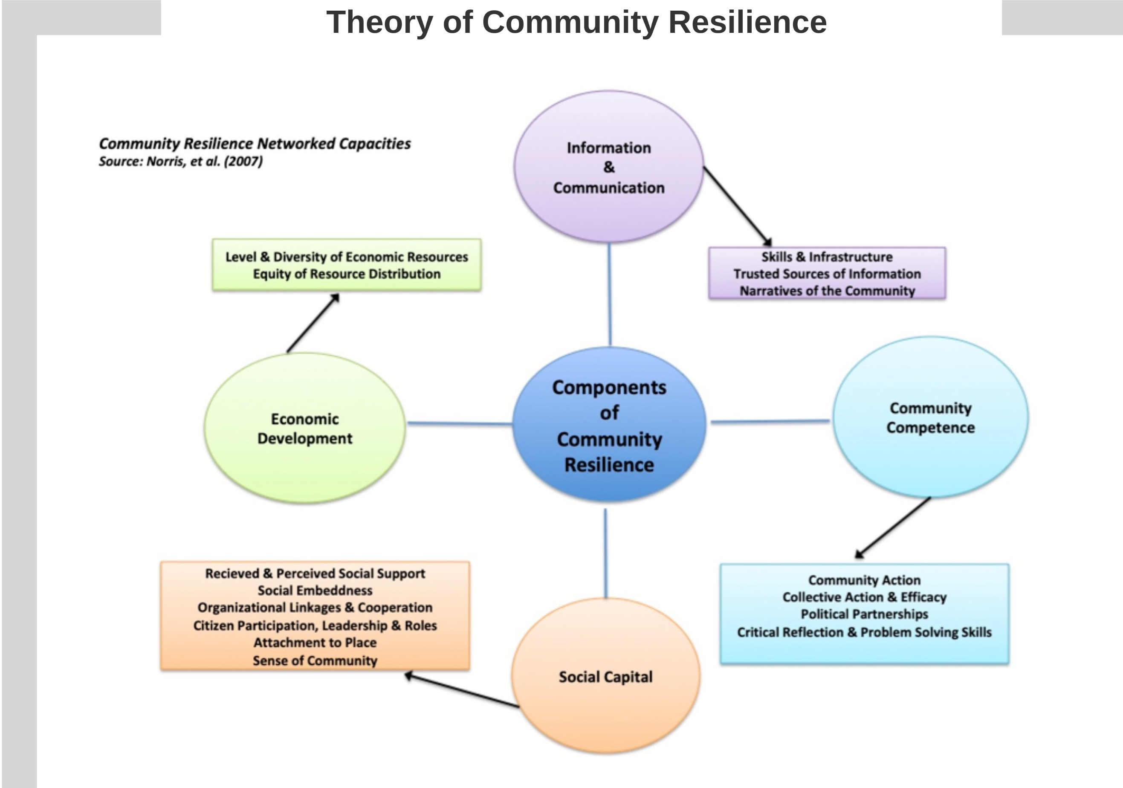

Slide 9
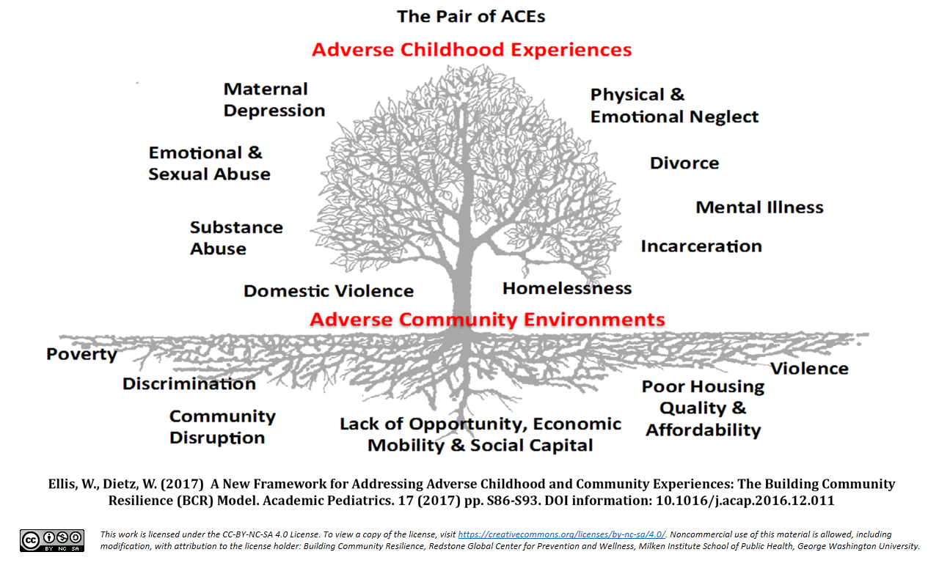
Systems Driven Adversity
Population Health & Community Outcomes
Policies
&
Systems
Trauma
Equity
Resilience

Slide 10
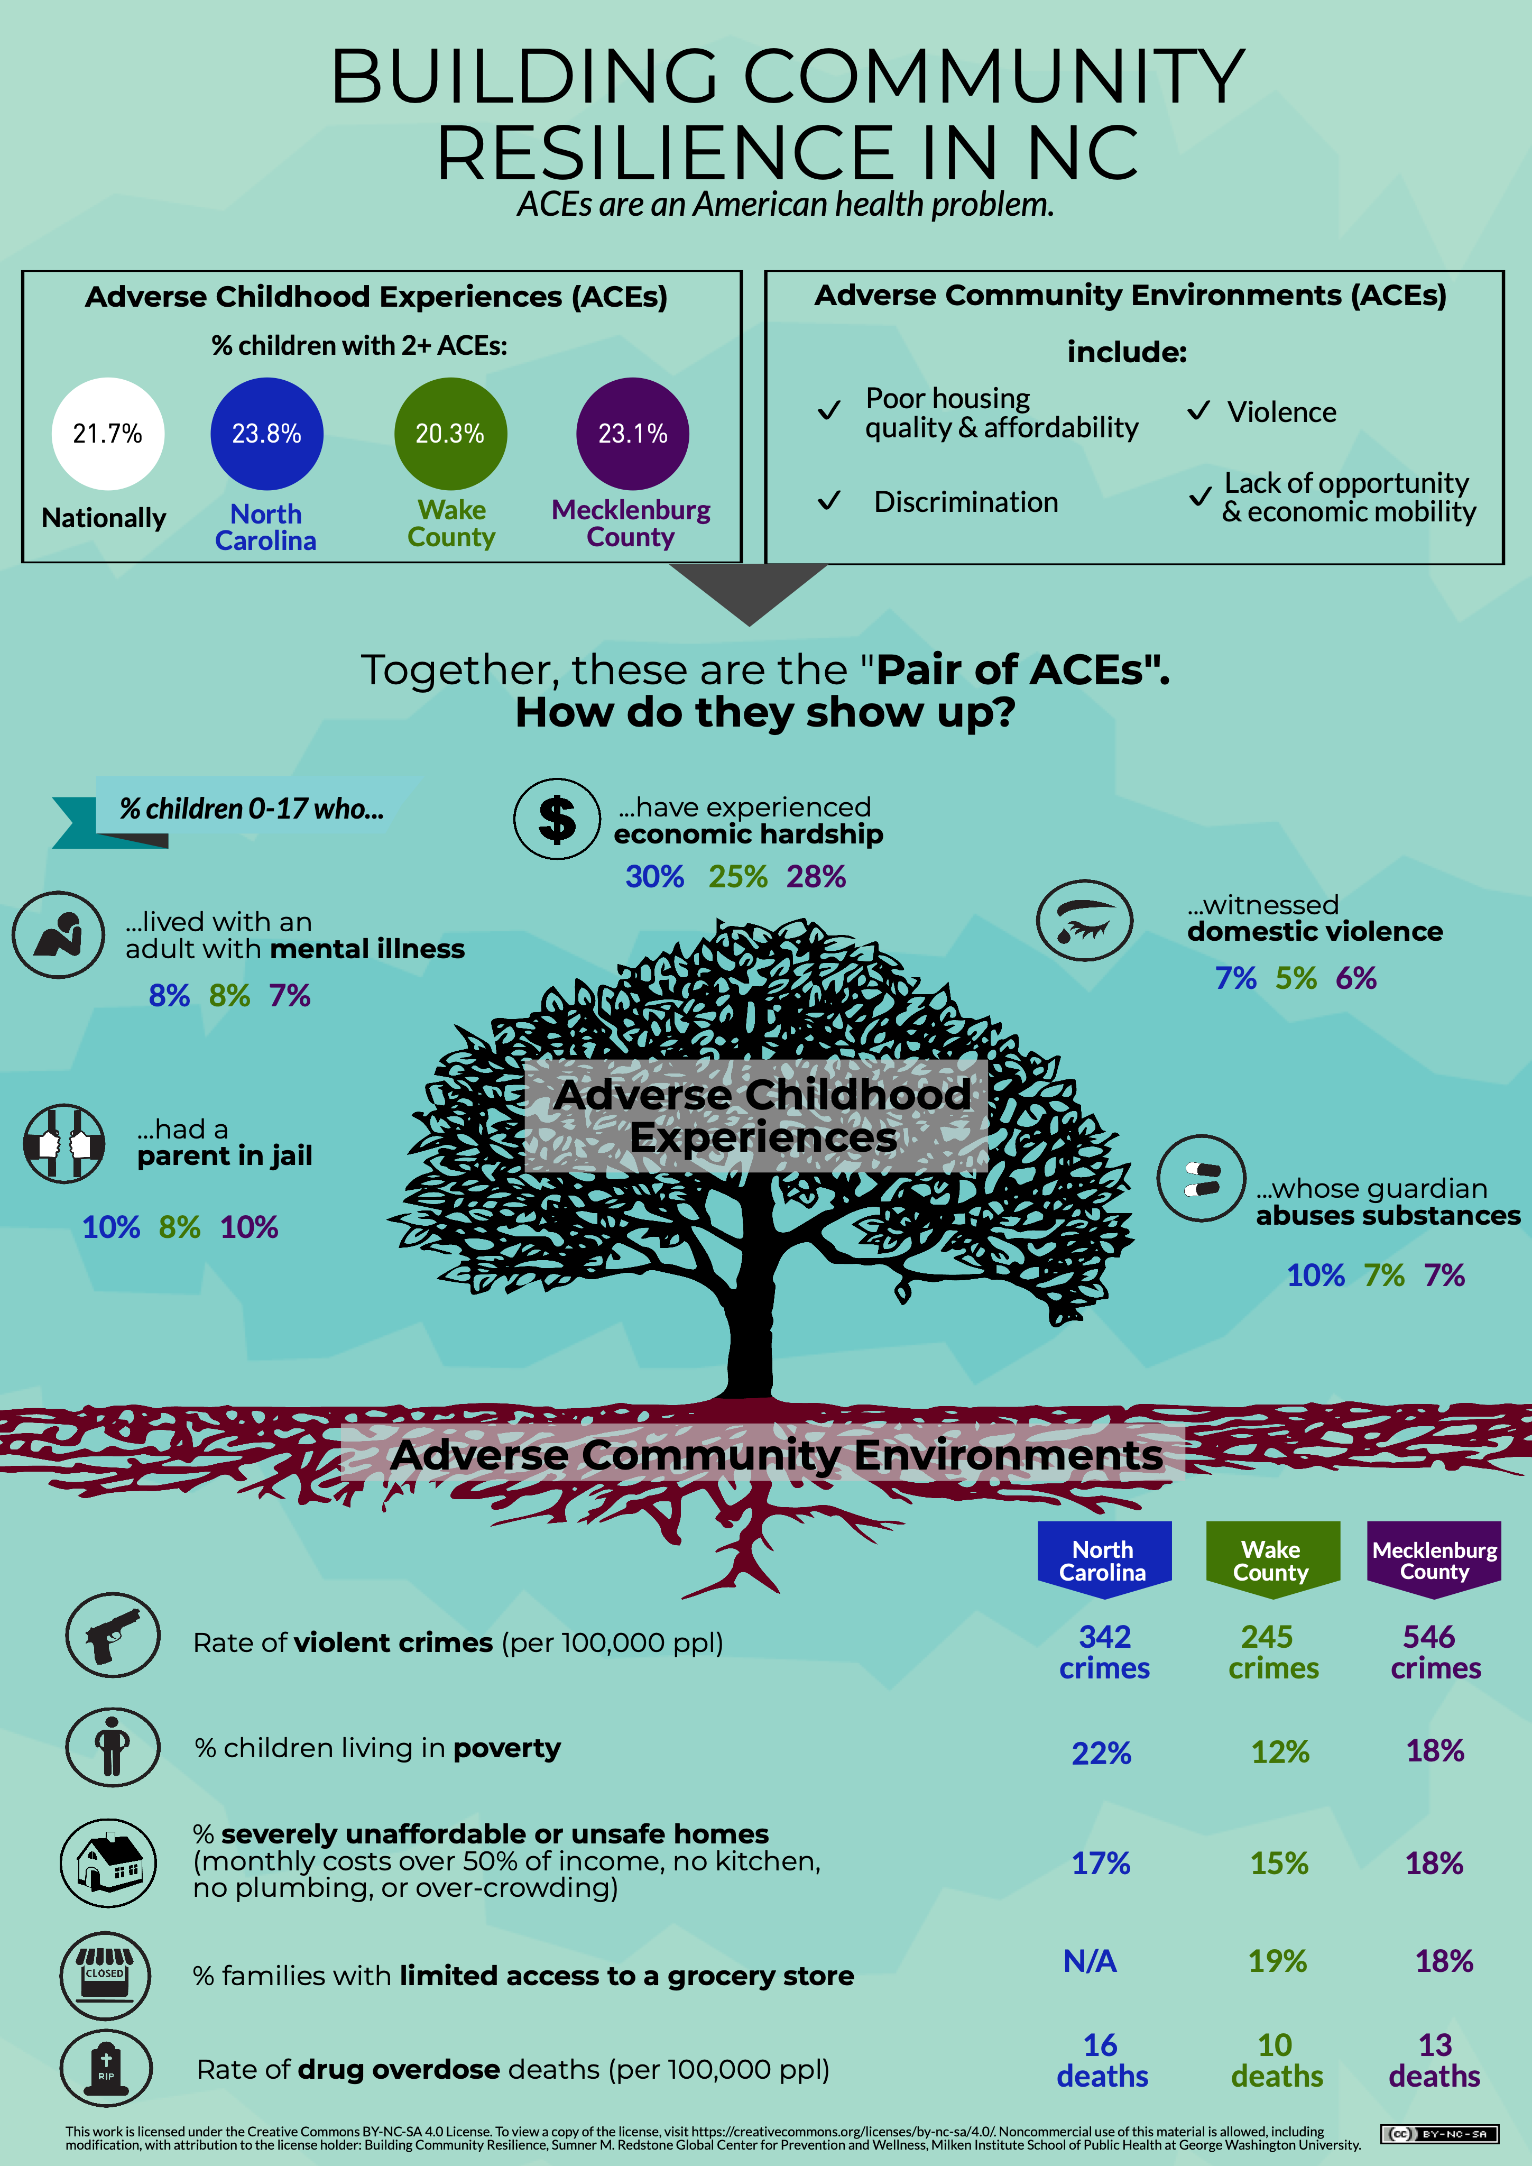
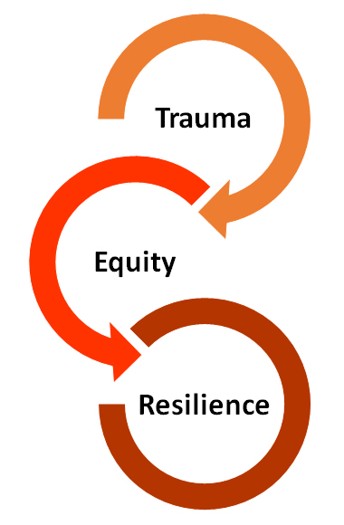

Slide 11
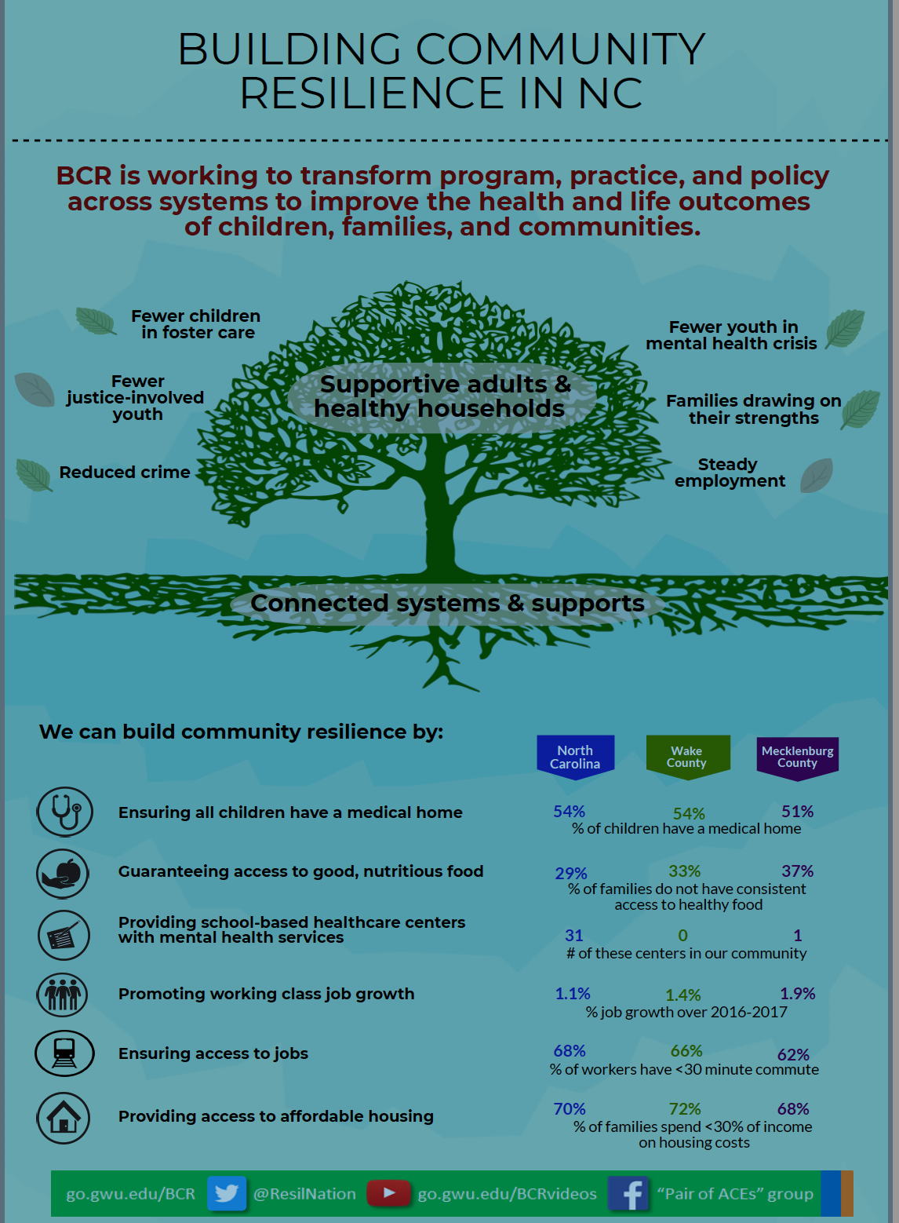
Create Shared Vision
Collaborate Across Sectors
Build Upon Best Practices & Programs
Foster Coordinated Efforts
Share Resources & Data
Promote Practice & Policy Change

Slide 12
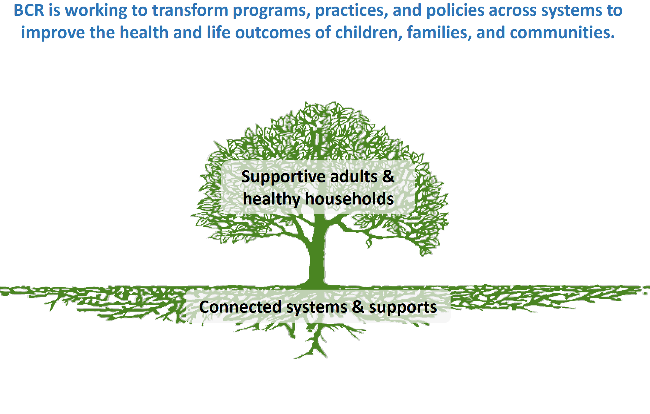
Activity- Identify Pathways to Resilience
What does resilience in the community and population you are serving look like?
What are the key indicators you can measure?
What additional systems need to be connected, transformed, integrated?

Slide 13
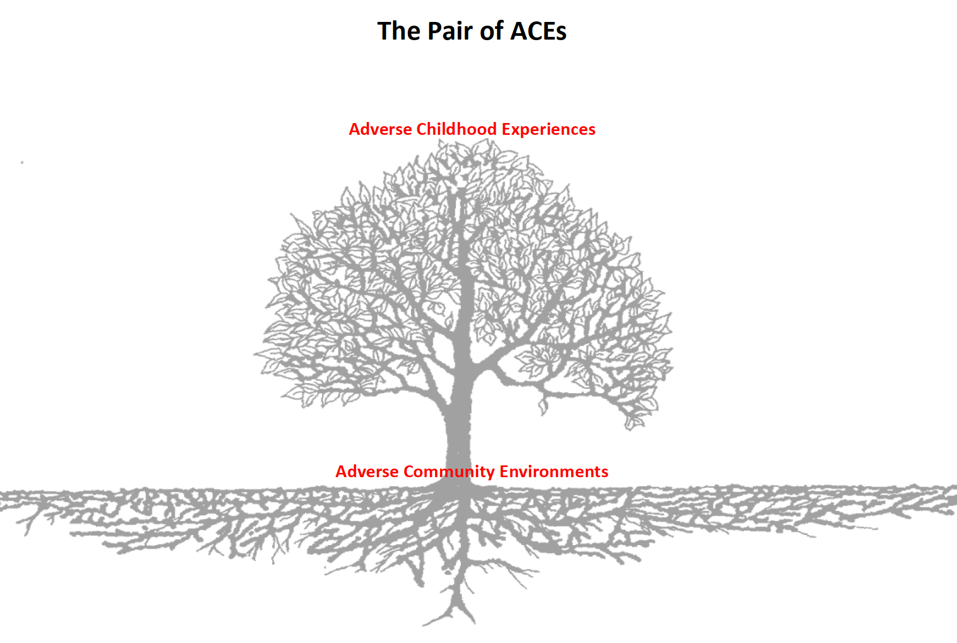
Activity- Identifying Adversity
What are some key individual measures of adversity in the population you are serving?
What are some key community level adversities?

Slide 14
Trauma Informed Care
A program, organization, or system that is trauma-informed realizes the widespread impact of trauma and understands potential paths for recovery; recognizes the signs and symptoms of trauma in staff, clients, families, and others involved with the system; responds by fully integrating knowledge about trauma into policies, procedures, practices, and settings and seeks to actively resist re-traumatization. SAMSHA
A trauma-informed approach is designed to avoid re-traumatizing those who seek assistance, to focus on "safety first" and a commitment to "do no harm," and to facilitate participation and meaningful involvement of consumers and families, and trauma survivors in the planning of services and programs. It also requires, to the extent possible, closely knit collaborative relationships with other public sector service systems. (Harris and Fallot, 2001)

Slide 15
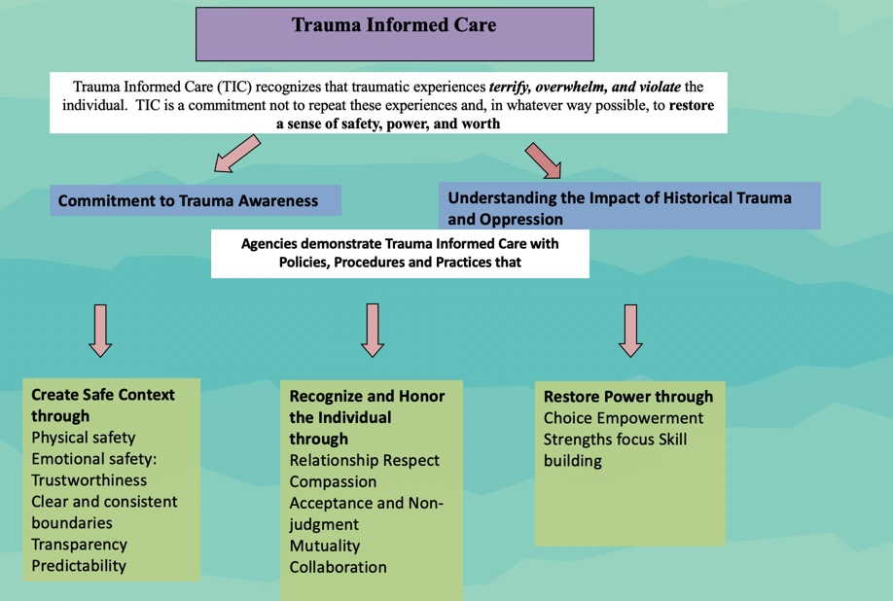
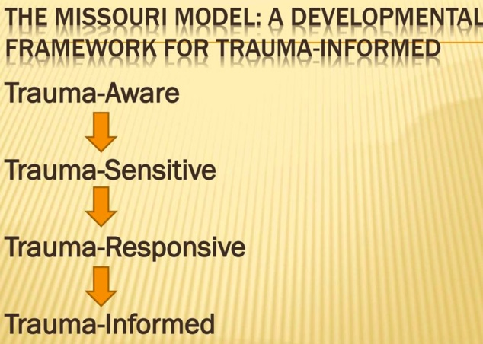
Trauma-Informed Frameworks
Source: Trauma Informed Oregon
Source: Missouri Model: A Developmental Framework for Trauma Informed Approaches, MO Dept. of Mental Health and Partners (2014).

Slide 16
Layers of Trauma
Poverty
Racism
Individual
Trauma
Community
Trauma
Gender Inequity
Lack of Access
Historical
Trauma
Systemic
Oppression
Xeno-phobia
Violence
Notes:
There is limited recognition of the various types of trauma that may impact an individual. Often, only interpersonal trauma is recognized as having an impact. While interpersonal trauma is often viewed as more correlated and tangible, lying underneath are all of the Adverse Community Environments – the community trauma. Community trauma has roots is historical mechanisms: racism, historical oppression of certain ethnic groups/religious groups, and transgenerational poverty. Note: While there is a national narrative of historical trauma, each individual community has its own unique presence of historical trauma that layers on top of the national narrative. Historical trauma is the result of systemic oppression, and systemic oppression continues to fuel historical trauma today.

Slide 17
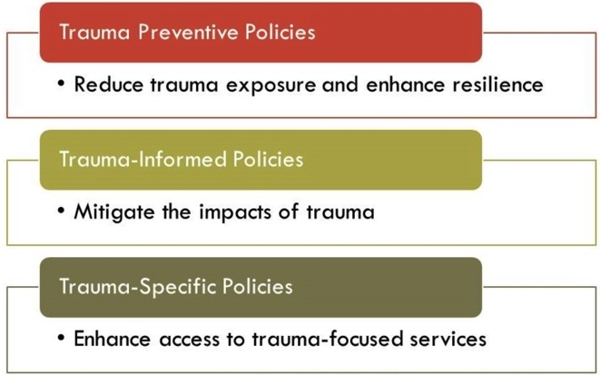
Types of Trauma Policies
Source: Purtle, Jonathan (2016)

Slide 18
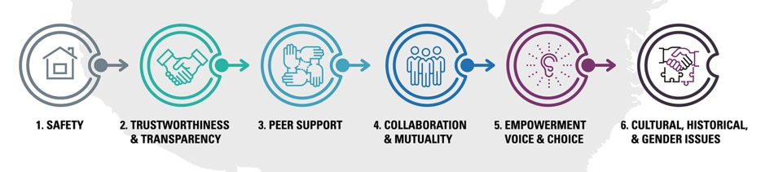
SAMHSA’s 6 Principles of a Trauma-Informed Approach

Slide 19
Trauma-Informed Approach as Policy Framework
Safety ➜ Supports for returning citizens
Trust & Transparency ➜ Implicit bias training
Peer Support ➜ Peer navigators for referrals
Collaboration ➜ Community ambassadors
Empowerment & Choice ➜ Enhance access to healthy food choices
Intersectionality ➜ Equity “Scorecard”
See e.g. Bowen EA & Murshid NS (2016) Trauma-informed social policy: a conceptual framework for policy analysis and advocacy. Am J Public Health 106, 223–229

Slide 20
Discussion
How have you (generally) incorporated trauma-informed principles into your goals work so far?
To what extent are your policy responses trauma preventive, informed, or specific?
Do your policy responses reflect the 6 principles and where are the gaps?
What are the barriers/challenges in conceiving and implementing a trauma-informed policy response for your project?

Slide 21
Jeff Hild
Policy Director, Redstone Center GWU School of Public Health
jeffhild@gwu.edu, 202.994.3637
@jeffhild1, @RedstoneGWSPH, @ResilNation
go.gwu.edu/BCR

