Slide 1
Planning for Seven Generations
Native American Lifelines
Dustin Tyee Richardson
Clinical Director

Slide 2
Planting Trees we’ll never sit under
How do we do with the complex issues with minority urban youth and new mothers?
Really talking about is fostering resiliency for the future

Slide 3
Trauma’s role in Native American life
Historical trauma
Intergenerational trauma
Individual trauma

Slide 4
How problems manifest

Slide 5
Developing Interventions
What we provide
Case Management
Behavioral Health
Counseling
Youth and Families Program
Telehealth
Family Spirit
Dental
Purchase and Referred Care

Slide 6
Community

Slide 7
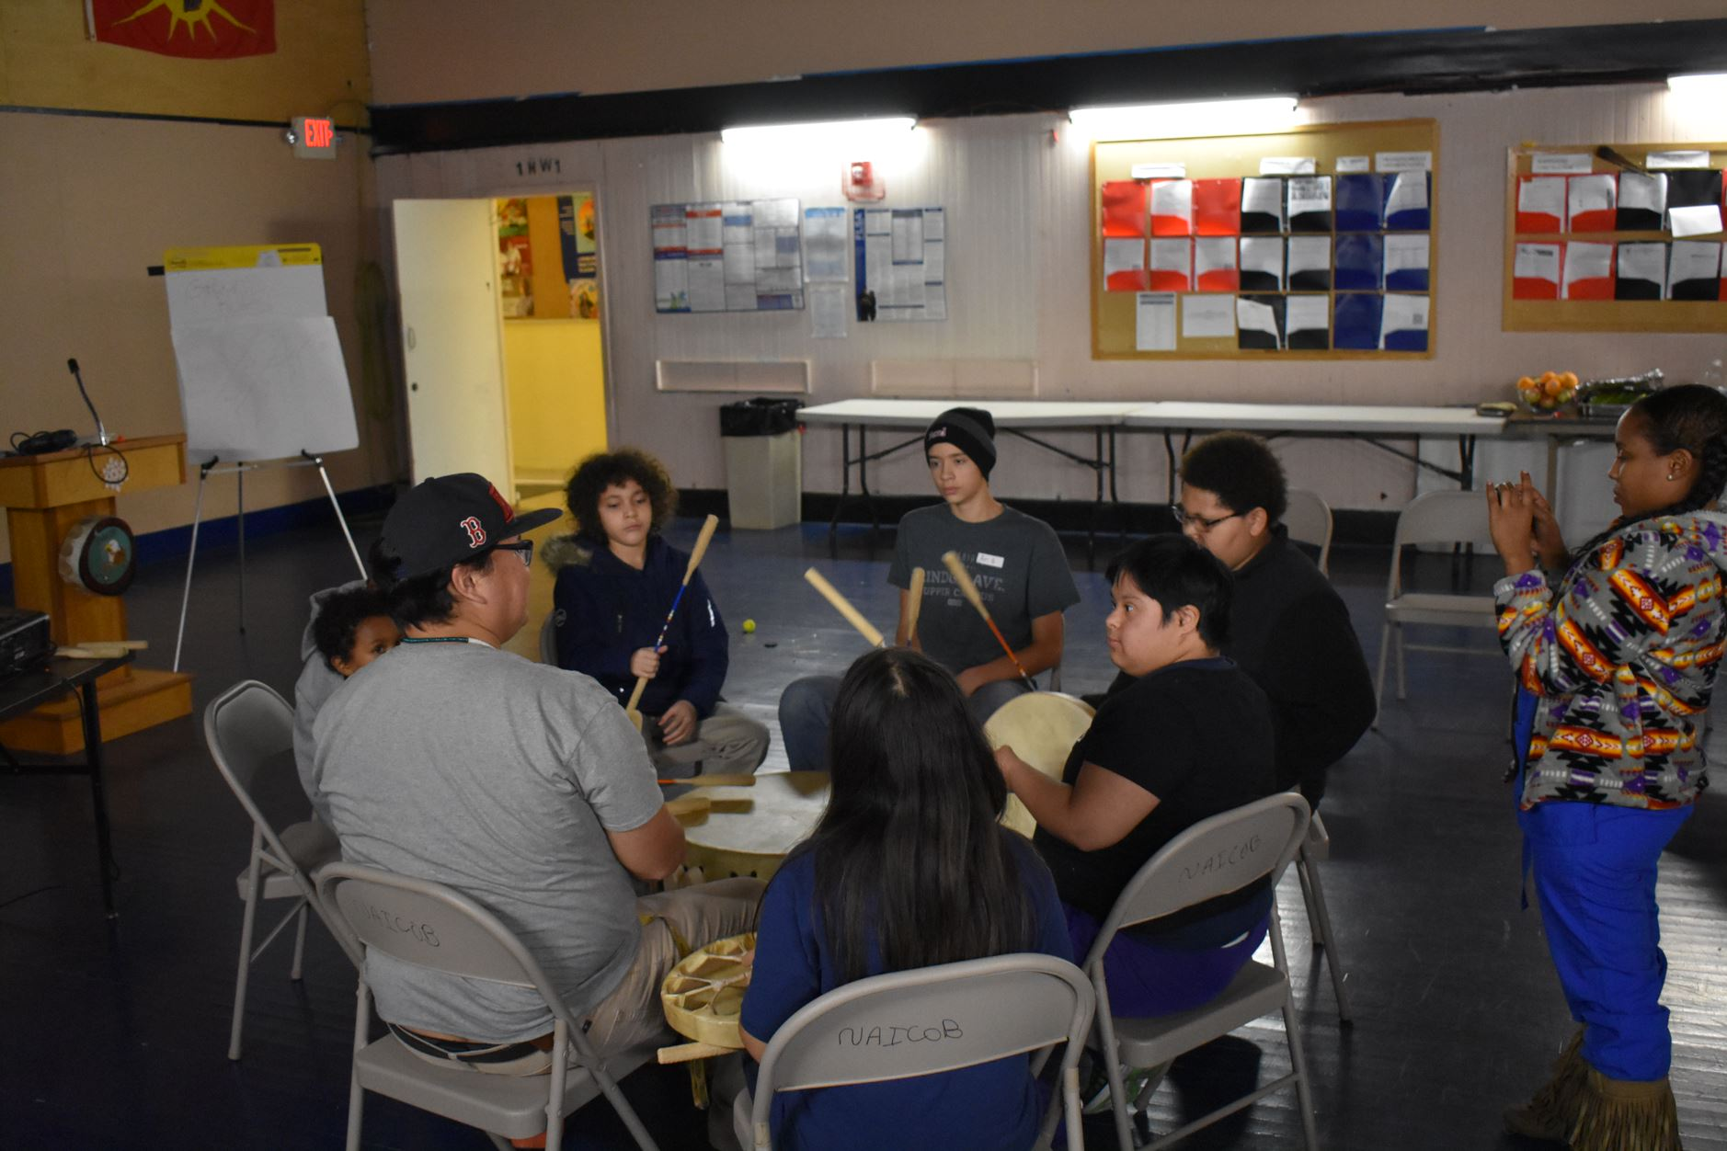
CUlture

Slide 8
Art

Slide 9
Education

Slide 10
Collaboration

Slide 11
Adaptation

Slide 12
Thank you

Slide 13
Contact information:
Direct line: 410-934-0636
Email: dustin@nativelifelines.org

