Slide 1
Project Overview
Moving on Maternal Depression (MOMD) & Policy Advancing Transformation and Healing (PATH)
Breaking Barriers, Building Communities
June 17, 2019
Notes:
Ruth

Slide 2
The Role of an Anti-Poverty Organization in Mental Health
Three million Americans living in poverty are either a mother who has experienced depression or a young adult who has experienced serious psychological distress during the past year.
Notes:
Nia– discuss intersection between anti poverty and MH. Why is an anti poverty org focusing on MH?

Slide 3
CLASP’s Racial Equity Lens
Cultural and linguistically critical approaches
Representative workforce
Equity
Access
Notes:
Nia

Slide 4
CLASP’s Approach to this Work
Framework development
Framework integration in early adopter states
Deepening relationships
Notes:
Ruth

Slide 5
Laying the Foundation
Informant interviews with agencies
Focus groups
Mental health advisory board
Stakeholder engagement
Notes:
Ruth (interviews with agencies and MH advisory board) + Nia (focus groups and stakeholder engagement)

Slide 6
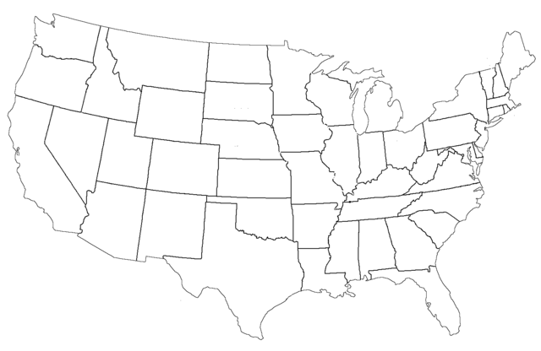
Maternal Depression State Scan, 2016
Notes:
Ruth

Slide 7
Young Adult Mental Health State/Locality Scans, 2018
Locality:
State:
Notes:
Nia

Slide 8
PATH’s Guiding Framework
Notes:
Nia

Slide 9
Notes:
Ruth

Slide 10
Notes:
Ruth

Slide 11
The Difference
Racial Equity
Bridging Systems
Partners & Advisors
Lived Experience
Notes:
Nia– what makes our work different?

Slide 12
Questions?
Ruth Cosse (MOMD)
Policy Analyst, Child Care and Early Education, CLASP
rcosse@clasp.org
Nia West-Bey (PATH)
Senior Policy Analyst, Youth, CLASP
nwestbey@clasp.org

