Slide 1

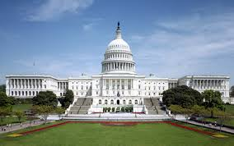

Alex Costello
Director of Legislative Affairs
Updates: Federal Legislation
June 2019

Slide 2
2019 Legislative Landscape
Appropriations
  FY 19 ends September 30th
  House Labor HHS-Ed Bill
    $191.7B in discretionary funding for FY 2020
    SAMHSA receives $5.9B - $115 million above 2019 level
Budget caps & sequestration
Oversight and Priorities

Slide 3
116th Congress Legislation
Families First Prevention Act
Substance Use-Disorder Prevention that Promotes Opioid Recovery and Treatment (SUPPORT) Act
Childcare for Working Families Act
Stronger CAPTA (Child Abuse Prevention and Treatment Act)
MOMMA Act
RISE from Trauma Act
Oversight committee trauma agenda

Slide 4
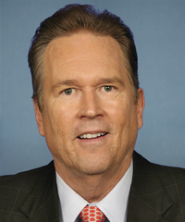
Families First Prevention Act
Signed into law 2/19/2018
Ways & Means Committee
Summary:
  Strengthen families so more children avoid unnecessary placements in foster care
  Help to ensure family-based care for children who need foster care
  Incentivize states to reduce placement of children in congregate care and promote adoption
Rep. Vern Buchanan (R-FL-16)

Slide 5
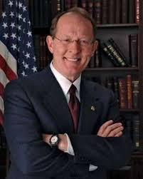
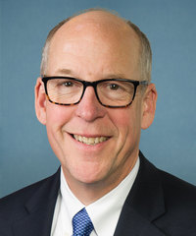
Substance Use-Disorder Prevention that Promotes Opioid Recovery and Treatment (SUPPORT) Act
Signed into law 10/24/18
Energy & Commerce Committee
Summary:
  Implements Medicaid and Medicare reforms to address the opioid crisis
  Direct the Food and Drug Administration (FDA) to issue or update guidance on ways existing pathways can be used to bring novel non-addictive treatments for pain and addiction to patients
Sen. Lamar Alexander (R-TN)
Rep. Greg Walden (R-OR-2)

Slide 6
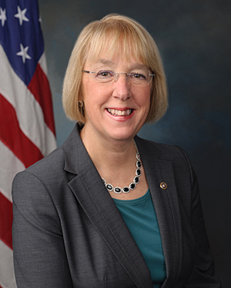
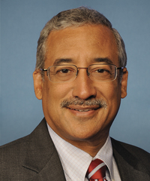
Childcare For Working Families Act
Introduced 2/26/2019
Ed & Labor/HELP committees
Summary:
  Support access to high-quality preschool programs for 3- and 4-year olds
  Significantly improve compensation and training for the child care workforce
  Implements sliding scale to determine childcare costs
    Families under 150% of state median income pay 7% or less on childcare
    Families under 75% of the state median income will not have to pay anything
Sen. Patty Murray (D-WA)
Rep. Bobby Scott (D-VA-3)

Slide 7
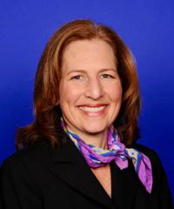
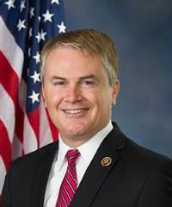
Stronger Child Abuse Prevention and Treatment Act (CAPTA)
CAPTA originally enacted in 1974; last reauthorized in 2010
Ed & Labor Committee
Passed the House 5/20/2019 and referred to the Senate
Summary:
  Authorize $540 million for the expansion of state and federal prevention services and new research
  Improve quality of federal and state data
  Address racial bias in child welfare system
Rep. Kim Schrier (D-WA-8)
Rep. James Comer (R-KY-1)

Slide 8
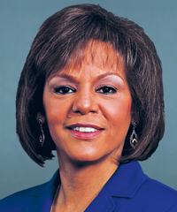
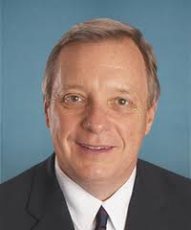
Mothers and Offspring Mortality and Morbidity Awareness Act (MOMMA) Act
Introduced 3/27/2019
Energy & Commerce Committee
Summary:
  Extends postpartum care access for Medicaid and CHIP recipients from 60 days after birth to 1 year
  Designates Center for Disease Control and Prevention (CDC) as federal entity to collect uniform maternal mortality data
  Improves Access to Culturally-Competent Care
Rep. Robin Kelly (D-IL-2)
Sen. Dick Durbin (D-IL)

Slide 9
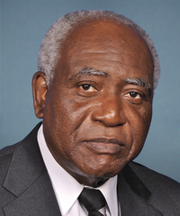
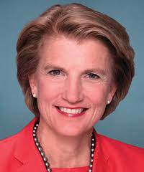
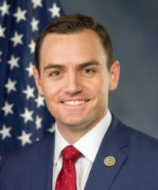
Resilience Investment, Support, and Expansion (RISE) from Trauma Act
Introduced 6/11/2019
HELP/Energy & Commerce Committee
Summary:
  Increase resources for communities to support children who have experienced trauma
  Address cycle of violence and addiction
  Strengthen nation’s trauma-informed workforce through training and targeted recruitment
Sen. Dick Durbin (D-IL)
Rep. Danny Davis (D-IL-7)
Sen. Shelley Moore Capito (R-WV)
Rep. Mike Gallagher (R-WI-8)

Slide 10
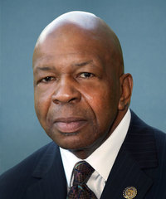
Oversight committee trauma agenda
July 17th: Survivor roundtable focused on educating the Oversight Committee members
July 18th: Oversight committee hearing
August 20th: District roundtable in Baltimore
Legislation planned for this Congress
Chairman Elijah Cummings (D-MD-7)

Slide 11
Looking Ahead
Ideas for engaging your federal delegation
Outlook for the rest of the 116th congress

Slide 12
Questions?

