Slide 1
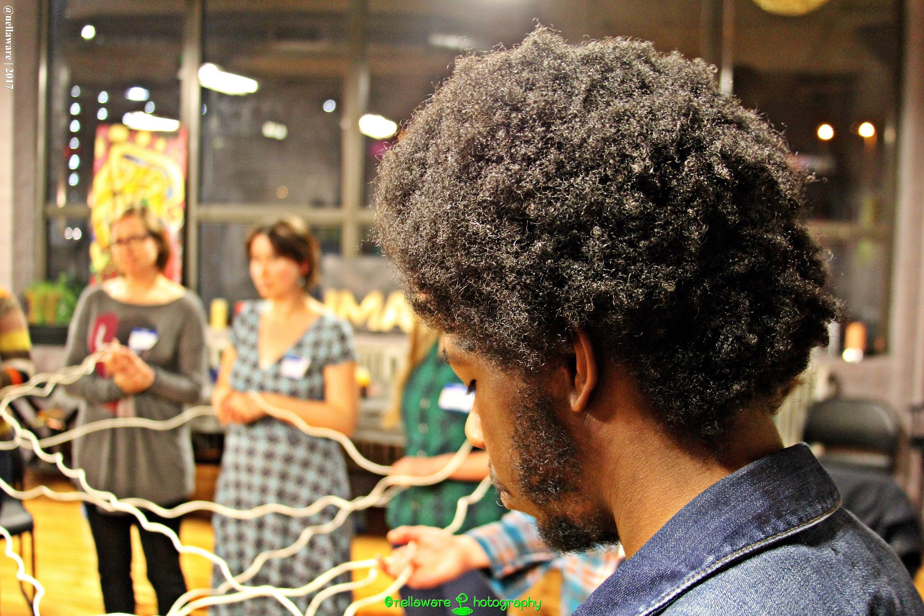
Breaking Barriers, Building Communities

Slide 2
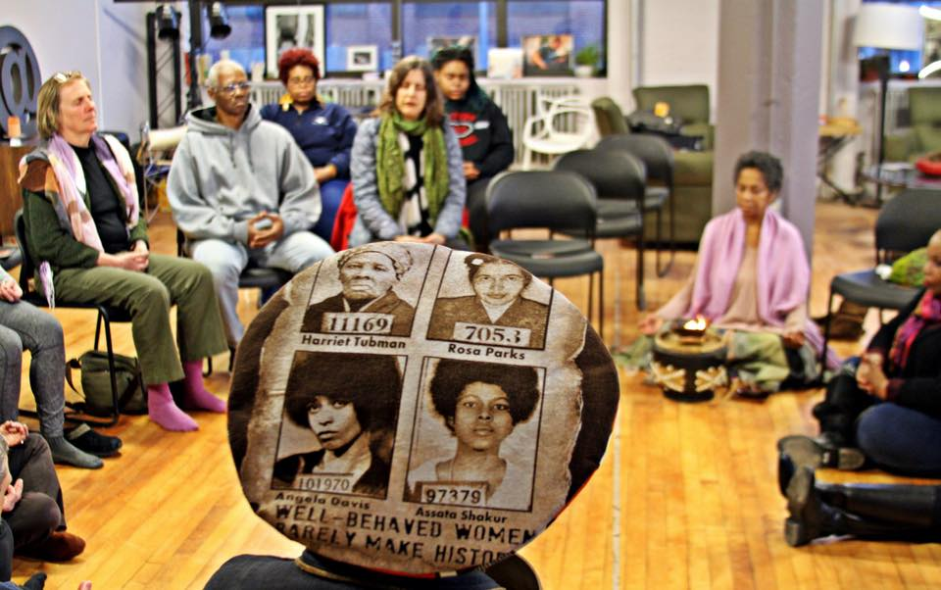
HEALING TECHNOLOGIES:
Pathways to Healing

Slide 3
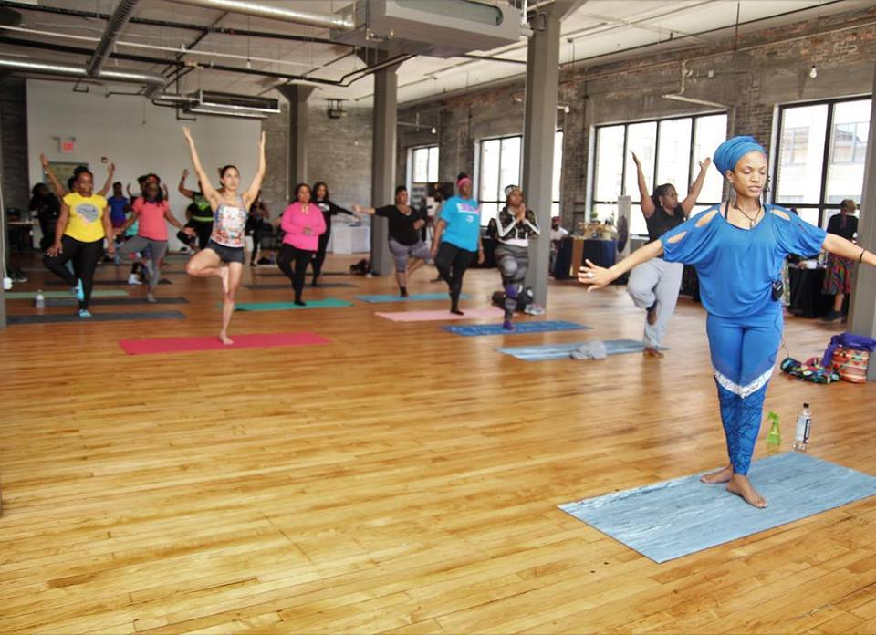
Healing
“The Process of making or becoming sound or health again.”
The Living Well is promoting Mindfulness to individuals who have not had access to healing technologies such as yoga and qiqong. We use a trauma responsive and a race equity approach to healing.

Slide 4
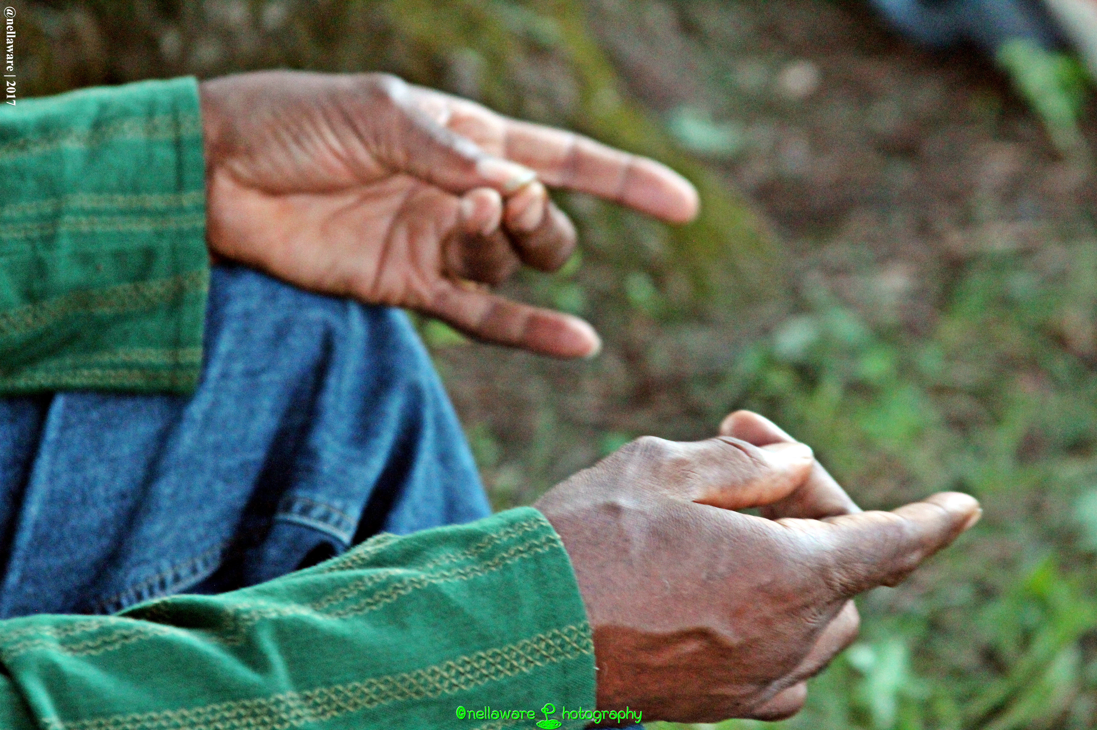
Mudras

Slide 5
What Is an Open System?
“An open system is a system that regularly exchanges feedback with its external environment.”
Open systems are systems, of course, so inputs, processes, outputs, goals, assessment and evaluation, and learning are all important.

