Slide 1
CHOP PolicyLab Breakout
June 17th 2019
Stacey Kallem | CLASP Meeting
Notes:
During this session we would hope you would share your recent research and findings in the maternal depression and young adult metal health space. Importantly, we hope you’d share how the findings are applicable to policy and systems change, particularly at the state level. Potential topics include your work on state-level advocacy, family support in pediatric settings, young adult parents, or depression screening implementation efforts. We are hoping all of our workshops are interactive and provide participants an opportunity to engage in the workshop and conversation.

Slide 2
Workshop goals
To highlight research & clinical innovation on maternal depression and adolescent mental health from PolicyLab at Children’s Hospital of Philadelphia
To discuss recent policy developments that could support maternal depression

Slide 3
icebreaker
Take 2 minutes to answer the following questions on your own and then be prepared to share with the group:
What do you see as the biggest challenge in your state related to maternal depression and/or young adult mental health? What are some of the programs or policies you are exploring?

Slide 4
Overview of policylab
2. CHOP Young Adult Mental Health Work
3. CHOP Maternal Depression Work
4. Policy Exploration

Slide 7
CHOP Young adult mental health Work
Overview of PolicyLab
CHOP Maternal Depression Work
Policy Exploration
Notes:
Possible turn to your partner and discuss point?

Slide 8

Adolescent depression
Rates of depression surge in adolescence
Treatments can reduce only 1/3 of the disease burden
Early identification & prevention are key
  22-38% of depression episodes can be prevented
Deliver these prevention programs in community settings to increase access

Slide 9

Clinical practice: Healthy minds healthy kids (HMHK)
Most youth with BH problems never receive treatment
  At least half of primary care visits involve BH concerns
  Integrated behavioral health offers an opportunity to identify youth early and get them into treatment
  HMHK launched in 6 practices in 2016 with a plan for expansion
Notes:
Include or not?

Slide 10
Adolescent depression screening
Background
  Beginning in 2011, PHQ-9-M screener at 16 yo WCC → 2017 screener at all WCC for ages 12-21
  From 2011-2014: Screening rate of 76.25% across 27 primary care practices (n = 12,690)

Slide 11
Adolescent depression screening
Background
  Beginning in 2011, PHQ-9-M screener at 16 yo WCC → 2017 screener at all WCC for ages 12-21
  From 2011-2014: Screening rate of 76.25% across 27 primary care practices (n = 12,690)
Results
  74.09% of patients had scores in the normal range
  19.23% had scores in the subthreshold range, and
  6.73% had scores in the threshold range
  8.6% of patients (N = 597) were flagged for suicide risk

Slide 12
Immediate PCP Responses for Patients with Threshold Symptoms

Slide 13
Immediate PCP Responses for Patients with Subthreshold Symptoms

Slide 14
CHOP Maternal depression work
Overview of PolicyLab
CHOP Young Adult Mental Health Work
Policy Exploration

Slide 15
Children do better when their caregivers do better.
  Social Determinants of Health
  Mental/Behavioral Health
  Vaccinations
  Smoking Cessation
  Reproductive Health Care
  And more...
Notes:
Should this be a discussion point?

Slide 16
PEDIATRICS AS A HEALTH CARE TOUCHPOINT
  3 in 10 high-risk mothers do not attend the recommended postpartum visit
  Over 90 percent of children attend well-child visits once a year
  Centers for Disease Control and Prevention. (2007). Postpartum care visits 11 states and New York City, 2004.
  Child Trends Data Bank. Parental Depression, August 2014.

Slide 17



Postpartum depression & pediatrics
Development
Breastfeeding
Infant safety
Notes:
? cut

Slide 18
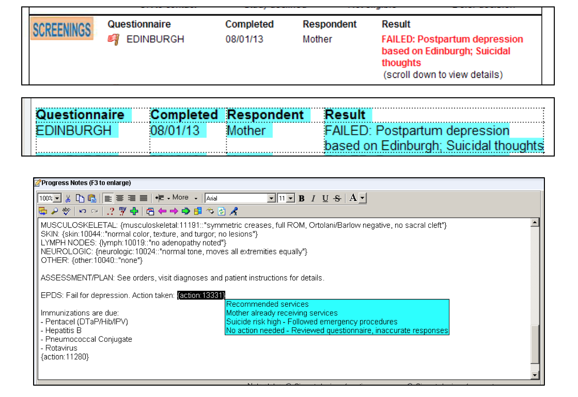
Clinical Practice
Postpartum depression screening integrated with electronic medical record
  Implemented through all 31 of CHOP’s Care Network sites at baby’s 2-month well visit
  Screening is automated, assigned at check-in where the mother is given a tablet to complete the screening
    Screening results flow into chart to be viewed by provider at visit; handouts, referral suggestions, follow-up recommended as needed
Since 2013, more than 46,000 screenings have been completed across the CHOP Care Network
Notes:
· All 31 sites in CHOP’s Care Network (primary care) are currently using the Edinburgh for postpartum depression screening at a baby’s 2-month well visit.
· The screening occurs through an automated process, where the questionnaire is prompted and assigned at check-in based on logic behind the scenes (which looks at the patient’s age and visit type). The mother is then handed a tablet computer to complete the screening.
· Those screening results immediately flow into the chart that’s viewed by the provider during the encounter, and the EHR also provides some decision support (handouts, referral suggestions, follow-up procedures for endorsed suicidality) as needed.
· As part of the CHIPRA Quality Demonstration Project in partnership with the PA Medicaid office, we switched to our current EHR-based screening process in summer 2013. We first piloted this process at a few sites, but due to its success it was eventually transitioned to an operational process across the entire network. Since that time, approximately 46,500 Edinburghs have been completed to date across the entire network.
· 11,500 of those questionnaires above were completed at our 3 inner city PCP locations, where approximately 70% of patients are covered by Medicaid.
o Note that the screening was rolled out in a phased implementation; some sites went live in 2013, and a few remaining sites just went live in 2018. It looks like we now average about 1,100 screenings per month at the 2-month well visits across all 31 sites.
· In accordance with PA EPSDT guidelines, have been billing CPT 96161 for those 2-month well visits with a completed Edinburgh since February 2018. We are not billing commercial insurance at this point, but things will likely change in the future.
· Due to the recent AAP/PA EPSDT mandates, the network will be expanding screening to all 1-, 2-, 4-, and 6-month well visits at some point in the next few months, but we are still working out some logistical issues and don’t have a date yet. After that occurred, then our screening volume will increase significantly.

Slide 19
Mental health care utilization

Slide 20

Research portfolio overview
Home Visiting Integration
Social Media Intervention
Resource Mapping
Notes:
Mothers from the FB intervention reported positive benefits.
High attendance and acceptability shows promise for addressing intervention barriers.
Limitations-sample size, poor attendance of in-person group, differential loss at follow up

Slide 21
Future directions
Screening and treatment for caregivers of children with developmental disabilities
  Parents of children with developmental disabilities more likely to experience symptoms of depression
  In order to improve parental depression → support parent self-efficacy and family dynamics as a whole
Supporting caregivers with substance abuse challenges
  Specialized services and collaborations around opioid addiction and comorbid mental health conditions
Notes:
Screening and treatment for caregivers of children with developmental disabilities
Screen parents in clinical settings that treat children with disabilities

Slide 22
Future directions
Co-locating and/or integrating behavioral health services, including:
  Brief maternal health interventions within pediatric primary care
  Telehealth services
  Use of community health workers and care navigators to facilitate referrals
Parenting adolescents: Stoneleigh fellowship
  Help understand the needs of adolescent parents and male caregivers
  Leverage pediatric clinical setting to improve how needs of these caregivers are addressed
Notes:
Stoneleigh fellowship
Two-year, full-time fellowship beginning in 2019

Slide 23
Considerations for pediatric health systems
Unintended consequences in relationships with pediatricians
  Fear of DHS involvement
  Risk of compromising a trusted relationship between pediatrician and families
  Impact on attendance at pediatric and sick visits
Protections in electronic medical records
Boundaries in pediatrician’s role
Adapting dyadic therapies to be more replicable and scalable
Notes:
Children’s health records are discoverable
Examine the consequences of including parent mental health needs in child’s chart
How do we address this issue

Slide 24
Time out
Turn to the person next to you and discuss the following:
How do these findings align with what you are seeing in your state?
Where do you think more research is necessary?
Do you think any of the pilots discussed (ex: home visiting co-location, Facebook, behavioral health integration) could work in your state?

Slide 25
Policy exploration
Overview of PolicyLab
CHOP Young Adult Mental Health Work
CHOP Maternal Depression Work

Slide 26
Medicaid reimbursement in pediatric settings
…since the maternal depression screening is for the direct benefit of the child, state Medicaid agencies may allow such screenings to be claimed as a service for the child as part of the EPSDT benefit….
Mothers who are not Medicaid eligible may receive some benefit from diagnostic and treatment services directed at treating the health and well-being of the child (such as family therapy services) to reduce or treat the effects of the mother’s condition on the child…
  - Centers for Medicare & Medicaid Services, May 2016
Some Degree of Certainty in Reimbursement
  Obama-era reimbursement policy recently reinforced by Trump Administration
Opportunities
  What “counts” as dyadic therapy?
  Broadening to commercial payers
Notes:
Reimbursement mechanisms
More clearly defining reimbursement and practices currently allowed through Medicaid
Identifying additional policy changes needed
Understanding how to broaden to commercial payers
Policy opportunity for defining dyadic therapy

Slide 27
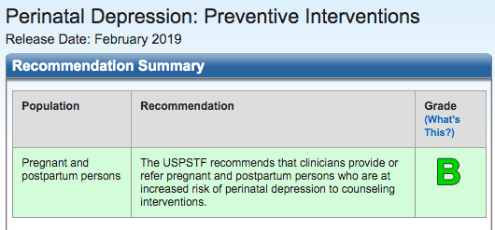
USPSTF Prevention recommendations
Notes:
Specifically recommends CBT and IPT

Slide 28
Early intervention & Maternal depression
State legislation:
Maternal depression as qualifying condition for early intervention
  Partner with Strong Moms Strong Babies Coalition in advocacy efforts
  Passed PA House
Notes:
EI:
Passed House, not law; should it pass in a future session, PL experts want to help inform implementation to maximize impact and efficiency
Reimbursement mechanisms:
PL is working to identify policy options/reimbursement mechanisms to make possible the treatment and more effective referrals for moms who screen positive for depression or depressive symptoms (for which we are working to build an evidence base and will describe in the next section) in order to ensure they have access to the care that they need. This will include more clearly defining reimbursement and practices that are currently allowed under the PA Medicaid policy and guidance from CMS bulletin, and policy changes that may be needed.

Slide 29
time out
With another partner, pick one of three policy topics discussed (Medicaid reimbursement, prevention reimbursement, early intervention referral) and discuss the following:
What would be the main challenges in moving this policy forward in your state?
Who are the major stakeholders you would need to engage?
What are some initial steps you could take to see this through?

Slide 30
kallems@email.chop.edu

