Slide 1

Transformative Change Initiative Webinar: The Alliance for Quality Career Pathways
September 12, 2014

Slide 2

Transformative Change Initiative (TCI)
Dedicated to assisting community colleges in scaling up innovation in the form of guided pathways, programs of study, and evidence-based strategies to improve student outcomes and programs, institutional, and system performance
Utilizing the window of opportunity of the Trade Adjustment Assistance Community College and Career Training (TAACCCT) program, TCI has been cultivating a growing and powerful community of TAACCCT grantees dedicated to scaling impact
TCI is managed in partnership with The Office of Community College Research and Leadership at University of Illinois and The Collaboratory, funded by the Bill & Melinda Gates, Lumina for Education, and Joyce Foundations

Slide 3
Transformative Change Initiative (TCI)
The TCI Community engages in participatory learning experiences to explore scaling innovations, gain critical insights and exchange ideas with peers, and hear from national experts on transformative change strategies, as we will hear today from CLASP.
TCI holds a series of learning events, that includes hosting a Learning Lab each year, webinars, and conference calls with thought leaders, and hosts a virtual platform to share ideas and promising practices.
OCCRL is also currently engaging in applied research with the TAACCCT community on the guiding principles of scaling change, implementing a community of practice for TAACCCT evaluators, and documenting successful scaling strategies and practices of TAACCCT consortia.

Slide 4

The Alliance for Quality Career Pathways
Vickie Choitz
Transformative Change Initiative (TCI)
Summer Webinar Series
September 12, 2014

Slide 5
CLASP: Policy Solutions that Work for
Low-Income People
CLASP develops and advocates for policies that improve the lives of low-income people.
Our Center for Postsecondary and Economic Success, launched in 2010, advocates for policies, investments, and political will that help increase the number of low-income adults and out-of-school youth who earn postsecondary credentials.
CLASP managed the Shifting Gears initiative and provided technical assistance to the six partner states. Shifting Gears supported state-level inter-agency teams to build pathways to postsecondary credentials for low-skilled adults in the Midwest.

Slide 6

Why Career Pathways and System Change to Support Them?
Increasing demand for credentialed workforce
The new “market” of credential earners is different from traditional students and has different needs
Today’s education and workforce systems designed for different times and different learners
Need an updated approach in order to –
  Meet employer demand for more educated and skilled workforce
  Smooth the path to economic security and prosperity for workers
  Sustain thriving communities
Notes:
Thanks, Whitney.
First, I think it’s important to talk about the value proposition for the career pathway approach.
A greater percentage of the workforce needs postsecondary credentials than in the past - Carnevale research: from about ¼ in the 1970’s to 2/3s in the next decade.
New market of credential earners has different circumstances and needs than the traditional student market
older, working, supporting and raising families
need bite-sized chunks of education that are well-connected in a career pathway or lattice
need supportive services that are integrated into the education/skills model
need much tighter connections to employers and industry; this is a point of intersection for the career pathways approach and sector strategies
Work through rest of slide…

Slide 7
Recent Federal Support for Career Pathways
Grants
  Health Profession Opportunity Grants (HHS, 2010)
  Workforce Innovation Fund grants (DOL, 2012-2014)
  TAACCCT grants (rounds I - IV) (DOL, 2012-2014)
Guidance, TA, etc.
  Federal Career Pathways Institute (DOL and ED, 2010-2011)
  Joint letter of commitment to promote use of career pathways (DOL, ED, and HHS, April 2012)
  Advancing Career and Technical Education in State and Local Career Pathway Systems (OCTAE, 2012)
  Moving Pathways Forward technical assistance to build State career pathway systems (OCTAE, 2013)
  Federal Request for Information on Career Pathways (2014) – will inform federal CP efforts
Evaluation and Experimentation
  ISIS evaluation of career pathway programs (HHS, launched in late 2007; 10 year initiative)
  HPOG evaluations (HHS)
  Dept. of Education Experimental Sites Initiative – Pell for shorter-term training
Looking forward
  DOL “rejuvenating” their sector strategy and career pathways strategies and materials
  WIOA supports alignment and career pathways
  All indications are that the federal government will continue to support and promote career pathways

Slide 8
State and Foundation Support for
Career Pathways
~ a dozen states have explored or adopted career pathways for educationally underprepared adults and youth
  AR, CA, KY, IL, MA, ME, OH, OR, PA, VA, WA and WI
~13 have explored or adopted career pathway bridges
  IL, IN, KY, KS, LA, MD, MN, NC, OH, OR, VA, WA, and WI
Several states have explored or adopted career pathways for high school-to-college
Major national initiatives including:
  Ford Bridges to Opportunity
  NGA Pathways to Advancement
  Breaking Through
  Shifting Gears
  Accelerating Opportunity

Slide 9
The Alliance for Quality Career Pathways
Phase I (2012-2014)
Develop a framework that provides a shared definition of quality career pathway systems
10 States: Arkansas, California, Illinois, Kentucky, Massachusetts, Minnesota, Oregon, Virginia, Washington, and Wisconsin
National Advisory Group of ~15 national organizations and experts
State- and practitioner-driven; CLASP is the lead and facilitator
Funded by Joyce Foundation, James Irvine Foundation, and Greater Twin Cities United Way

Slide 10
Alliance, Phase II (2014-2015)
Partnerships implement the framework:
  Complete self-assessment tool and engage in continuous improvement
  Make progress on using Alliance participant metrics
CLASP analyze completed self-assessments and write series of briefs to inform the field
Purpose:
  Strengthen systems through a shared vision of and commitment to quality and continuous improvement
  Promote shared performance measures (for systems and participants)
  Improve the framework
  Improve career pathways for all participants, especially low-income, lower-skilled
Anchor funding from Joyce Foundation and Greater Twin Cities United Way

Slide 11
Overview – AQCP Framework: Three Parts
Definitions and conceptual model
  Career pathway approach (“big tent”)
  Sector-based career pathways and programs
  Career pathway systems
System criteria and quality indicators
  For state sector-based career pathway systems
  For local/regional sector-based career pathway systems
Career pathway participant metrics
  Includes interim, credential, and labor market outcomes
  For shared performance measurement and/or continuous improvement

Slide 12
Career Pathways Approach: “Big Tent”
The career pathway approach connects progressive levels of education, training, support services, and credentials for specific occupations in a way that optimizes the progress and success of individuals with varying levels of abilities and needs.
Helps individuals earn marketable credentials, engage in further education and employment opportunities, and achieve economic success.
Deeply engages employers and helps meet their workforce needs; helps states and communities strengthen their workforces and economies.
Not simply a new model; it is a systems transformation strategy.

Slide 13
Three Essential Features of Career Pathways
2. Multiple entry points – for both well-prepared students and targeted populations
e.g., apprenticeship
e.g., postsecondary system
informed by industry/employers
e.g., military or civilian workplace
credentials
e.g., high school or CTE
competencies, and
e.g., 4-year degree
skills,
e.g., 2-year degree
e.g., adult education or workforce system
Increasing
e.g., certificate, diploma
N^{th} Job in Career Path
3rd Job in Career Path
bridge(s)
e.g., license, industry credential
2nd Job in Career Path
1st Job in Career Path
1. Well-connected and transparent education, training, credentials, and support services
3. Multiple exit points

Slide 14
Four Essential Functions of
Career Pathways and Programs
1. Participant-focused education and training
4. Employment services and work experiences
2.Consistent and non-duplicative assessments
3. Support services and career navigation assistance

Slide 15
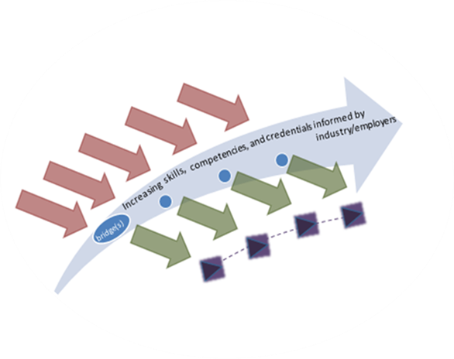
Career Pathway Systems
Local
Federal Agencies
State Career Pathway System
Local/Regional Career Pathway System
Career Pathways and Programs

Slide 16
Criteria for Quality Career Pathway Systems
    Commit to a shared vision and strategy
    Engage employers and integrate sector principles
    Collaborate to make resources available
    Implement supportive policies
    Use data and shared measures
    Implement and integrate evidenced-based practices and process (specifically for local/regional career pathway systems)

Slide 17
Alliance career pathway metrics will:
Measure key results for pathways
Capture educational and employment development milestones
Promote progression of participants
Support continuous improvement
Provide a basis for shared performance accountability
Provide a “common language” across partners for regional workforce development

Slide 18
Overview of career pathway metrics
Interim outcomes
Pathway education and training outcomes
Labor market outcomes

Slide 19


Local Regional
Career Pathways Systems
Rosa Itzel Lopez
LCC Career Pathways Coordinator
Lane Community College
Eugene, Oregon

Slide 20

Local Regional Career Pathways Systems an LCC example
Lane Community College (LCC) is one of 17 independently governed community colleges in Oregon.
LCC has 27 Career Pathway Certificates (14 entry level & 13 advanced) and over 40 roadmaps.
All 17 community colleges in Oregon are part of Pathways Alliance established in 2004 and lead by Statewide Coordinator.
Oregon has over 300 short term certificates with 7,600 certificate completers between 2008 & 2013, and over 350 roadmaps.

Slide 21
Building a Model Program
Early Childhood Education (ECE) example
The Players:
ECE faculty/ department
Local employers
Statewide professional registry
Local resource and referral
Current child care providers
Non-traditional students
ABE faculty/ department
Local school districts
Local workforce system

Slide 22

Critical Questions
How do we……..
…. create opportunities for professionals in the field?
…. align with current professional standards in Oregon registry?
…. help meet employer demand for multilingual /cultural providers?
…. serve large population of low skilled adults in this field?
…. ensure academic integrity?
…. meet ABE and ECE standards?
…. improve alignment with high school students?
…. best utilize internal and external services/programs?
…. build on work already being done?

Slide 23
Our Pathway & Implementation
First: We built a stackable system of certificates
Utilized agreed upon Credit for Prior Learning for courses in entry level certificates
Aligned with professional registry and industry needs for all certificates
Considered academic and basic skill sequencing among courses in AAS program
Next: We created an accessible implementation plan for success
Created an ESL/Credit co-enrollment “learning community” targeting appropriate courses
Contextualized the ESL class by use of ECE textbooks for teaching ESL skills
Targeted certificate courses for accessible options for professionals (evening, online)
Targeted entry level certificates for high school dual enrollment options
Partnered with other services and funding options.
Utilized TAACCCT funds to provide intrusive advising, navigation, and career coaching
*Ongoing improvements: LCC’s ECE Roadmap

Slide 24
Criteria and Indicators
Criteria 6: Implement and Integrate Evidence Based Practices and Processes
6.1:
well connected and transparent education, training, credential and support offerings
6.2, 6.3:
multiple entry points and multiple exit points
6.4:
participant focused education and training
6.7,6.8,6.10:
academic advising, career navigation, and employment services
6.11:
work experiences
*All 6 criteria are present and interconnected in this Career Pathway and everything is always in ongoing improvement.

Slide 25
Judy Mortrude
Minnesota Department of Employment and Economic Development
Judy.mortrude@state.mn.us

Slide 26
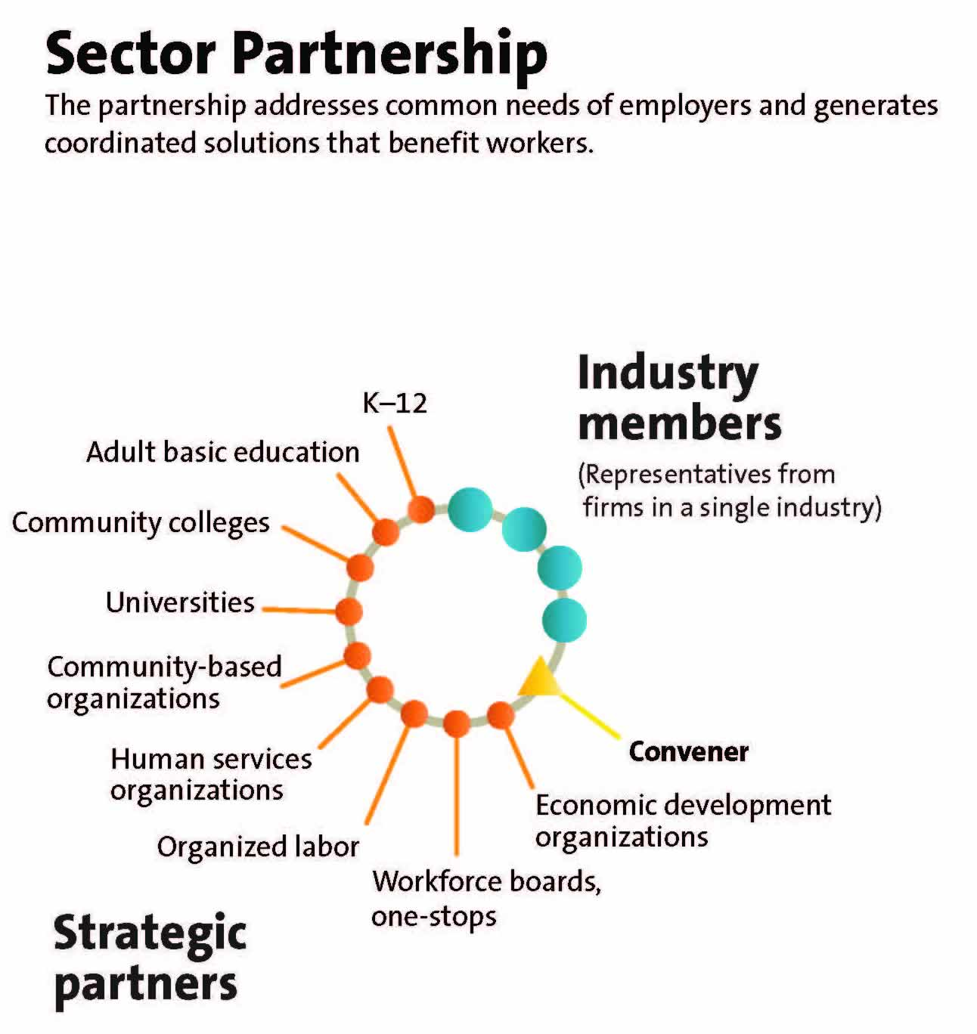
TAACCCT Work can be Transformative
Beyond programming to system building – but where to start?
2.2 System partners integrate key principles of sector strategies into the career pathway system
State Sector Strategies Coming of Age. NGA 2013
Notes:
transformative – to impact education and workforce development systems long beyond the specific funded activities supported by grant funds

Slide 27
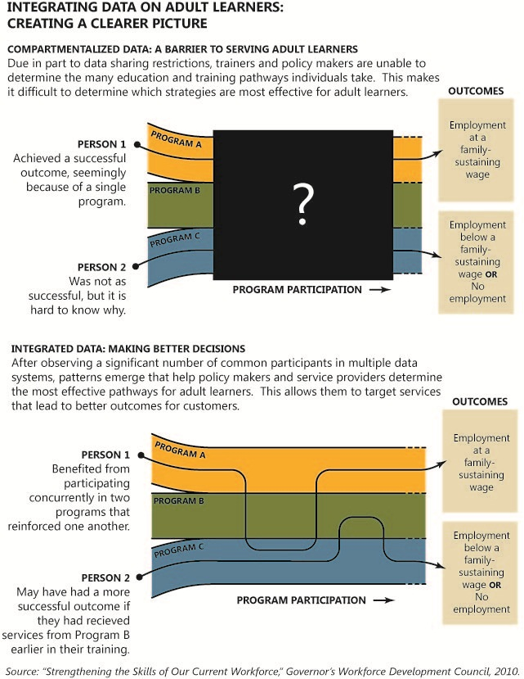
Shared Metrics
5.1: System partners develop the capacity and provide data, resources, and assistance to support the use of longitudinal data both at the state and the local/regional levels…
Notes:
Step one – have the same definition for “enrolled” for “completed” for “employed” for “wage gain” and the same way of measuring them. Go through the exercise of pipeline analysis – finding common customers across the systems and see what you learn; find a way to keep this turned out beyond the grant and you will be able to tell stories about that adult learner, that part time learner, that student who is becoming the majority student at two-year colleges

Slide 28
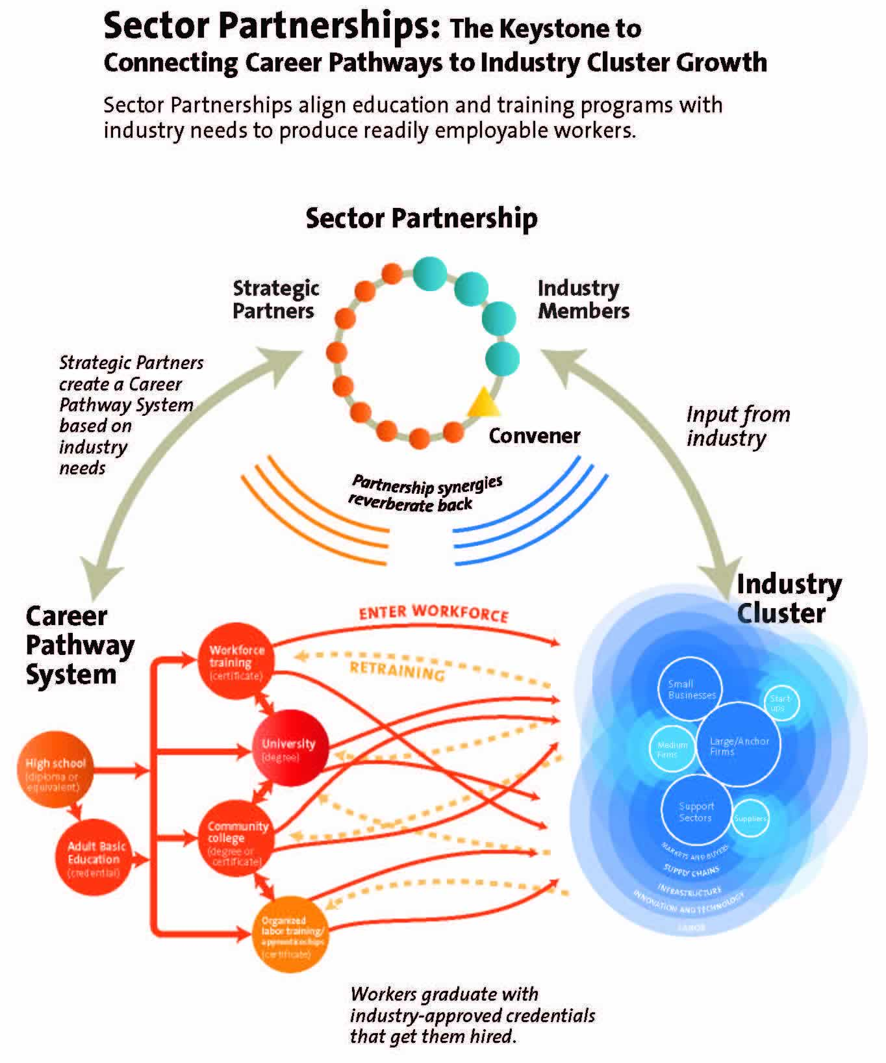
Work Toward a Shared Vision
State Sector Strategies Coming of Age. NGA 2013

Slide 29
TOOLS, TIPS & TACTICS
THANK YOU!
www.clasp.org/careerpathways
Vickie Choitz, Director
Alliance for Quality Career Pathways
CLASP
vchoitz@clasp.org
202-906-8048

Slide 30
TCI Information
Further information can be found at: http://occrl.illinois.edu/projects/transformative_change/
Contact information:
mfeldbaum@thecollaboratoryllc.com, 301-580-9166

Slide 31
THANK YOU!

